Slide 1

convolutional neural network - CNN
Dr. Abbas Malekpour

Slide 2
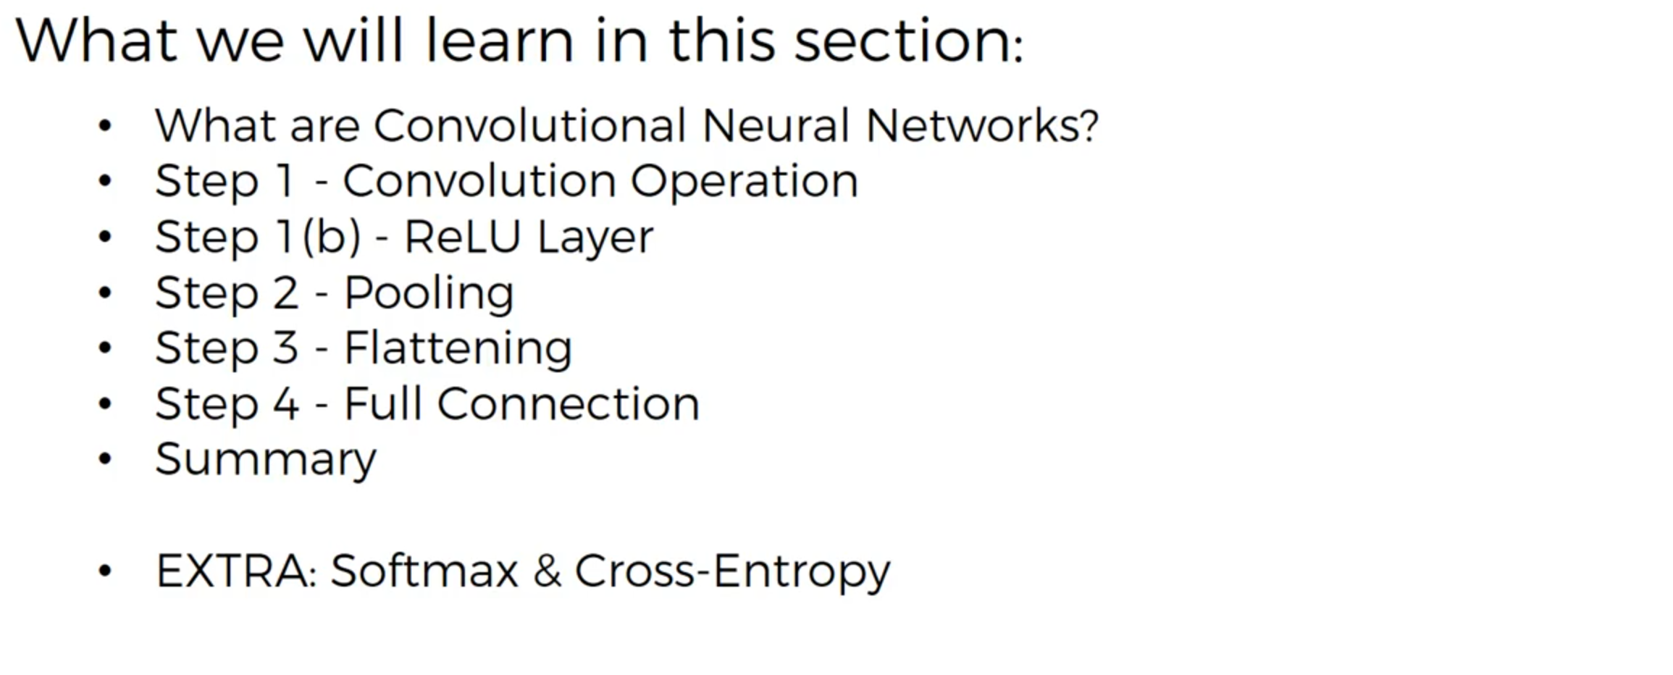
convolutional neural network

Slide 3
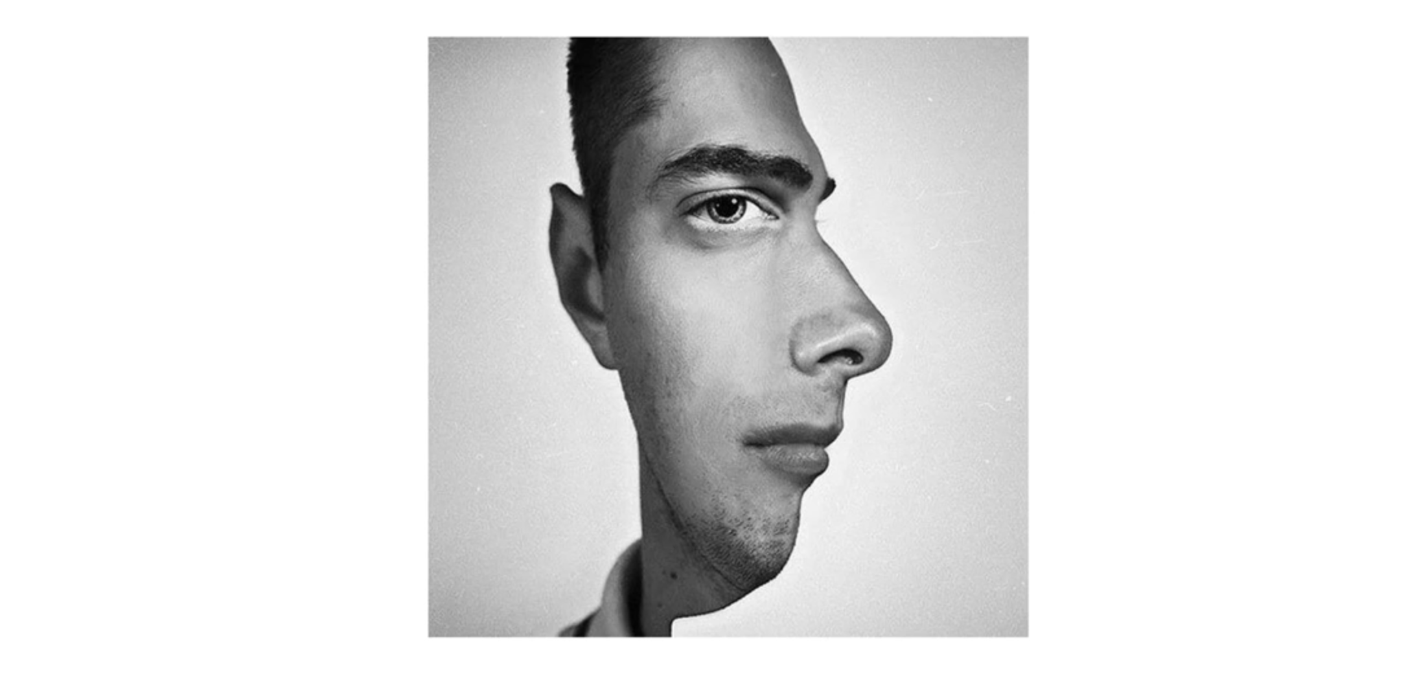
convolutional neural network

Slide 4
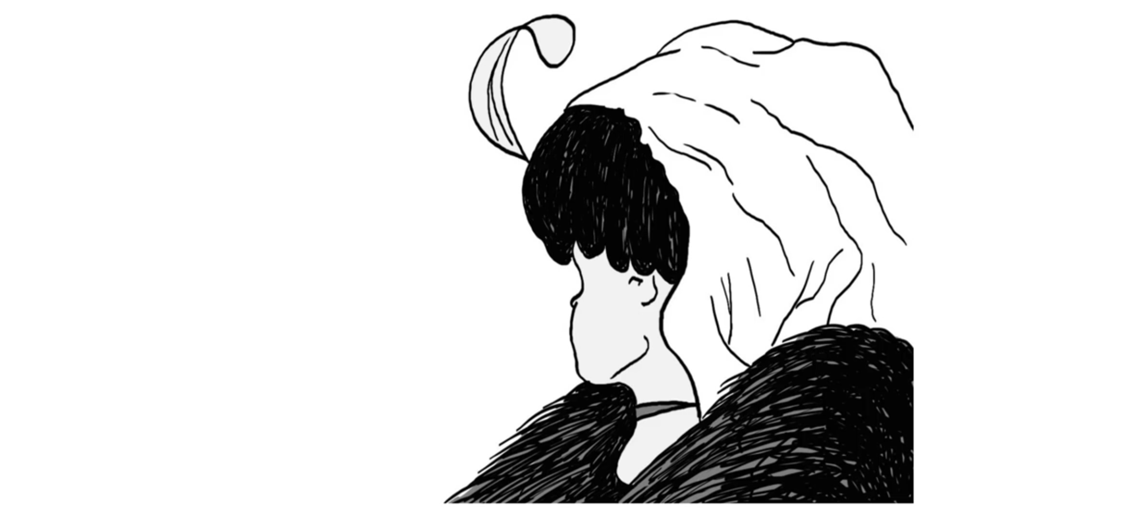
convolutional neural network

Slide 5
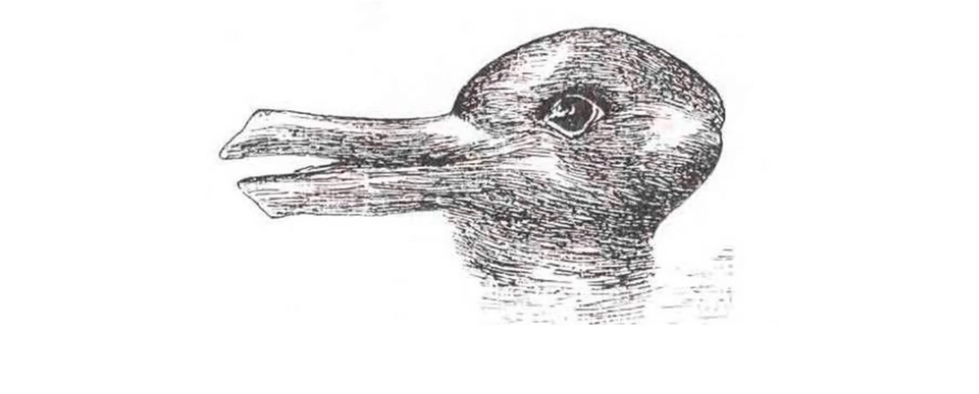
convolutional neural network

Slide 6
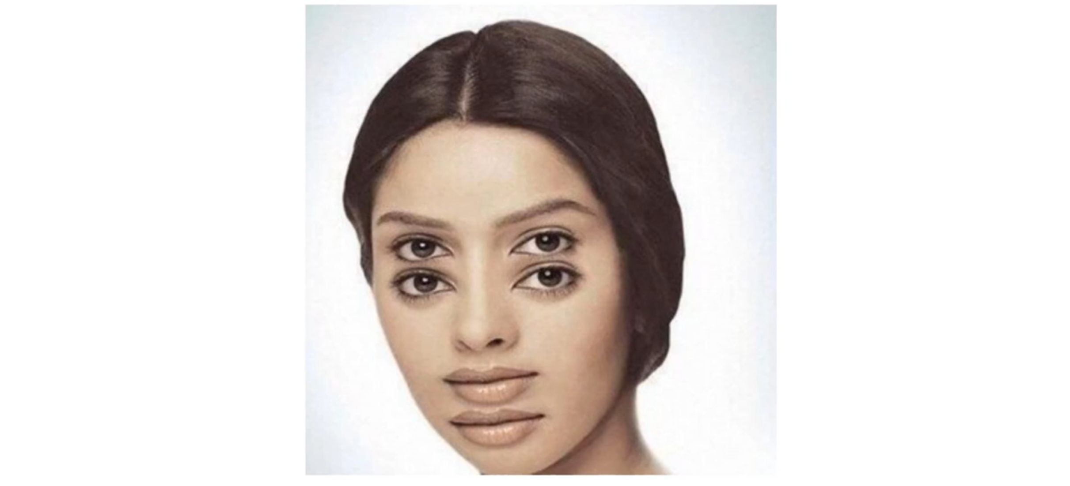
convolutional neural network

Slide 7
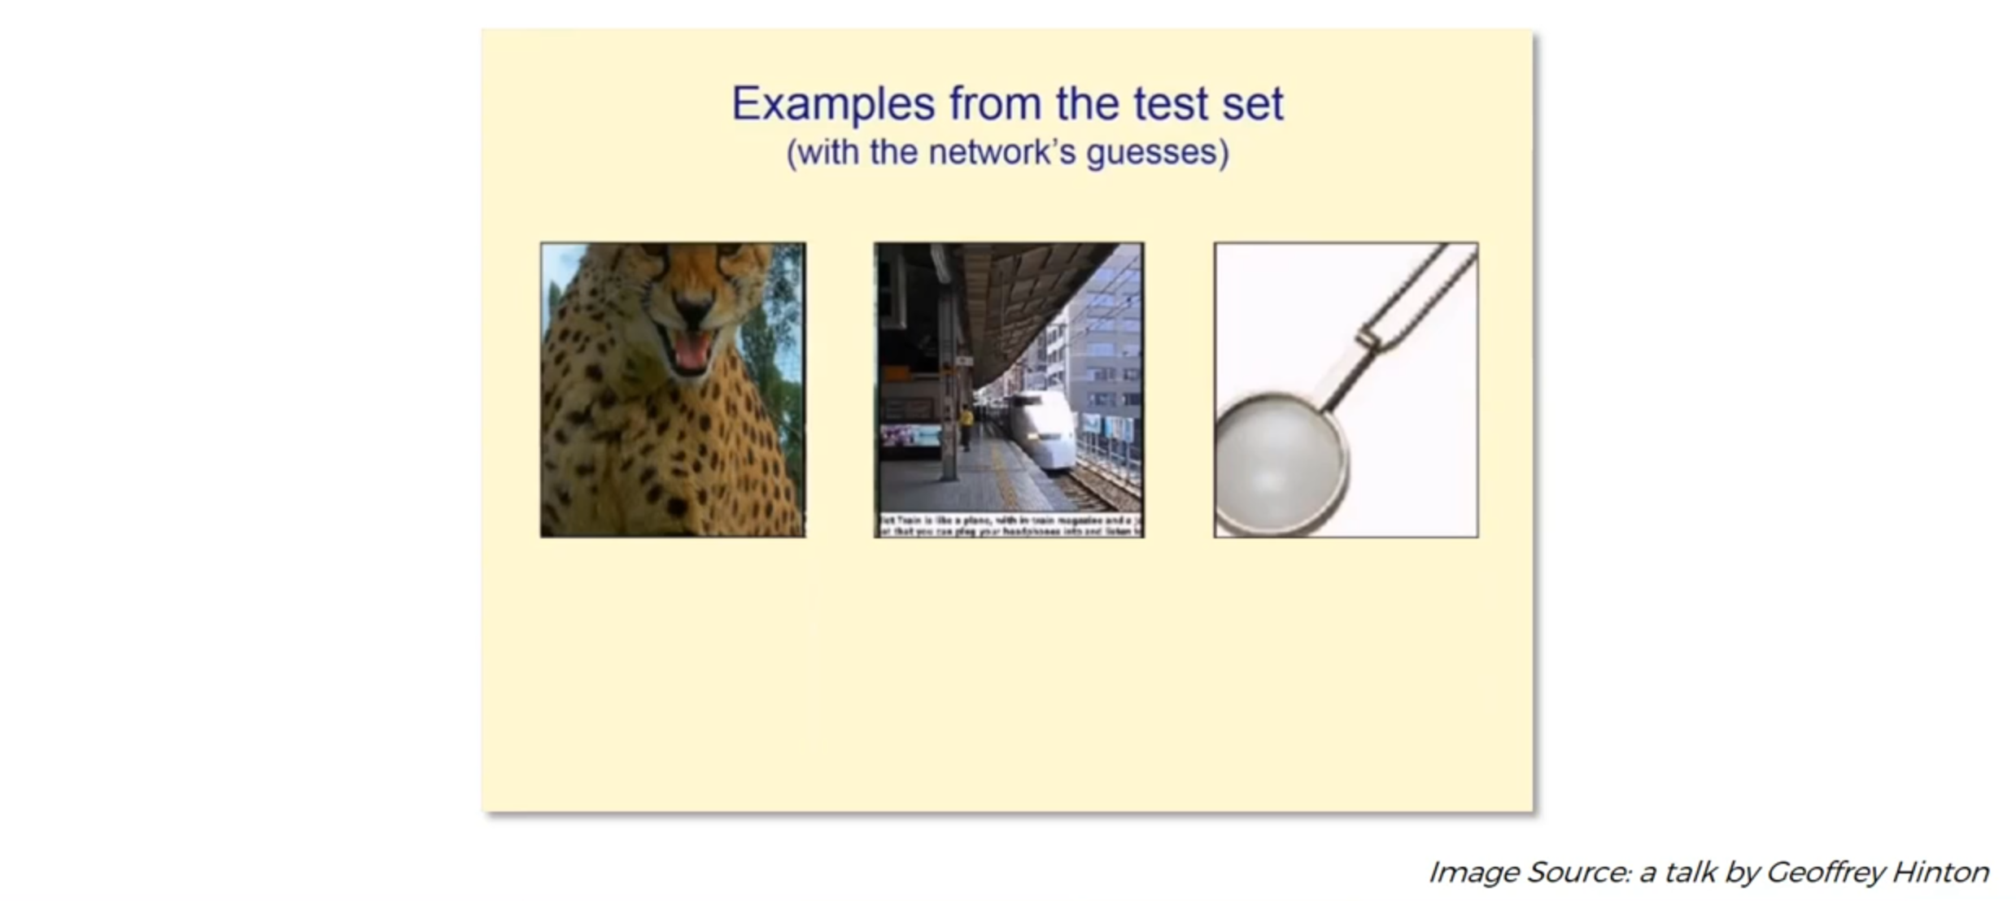
convolutional neural network

Slide 8
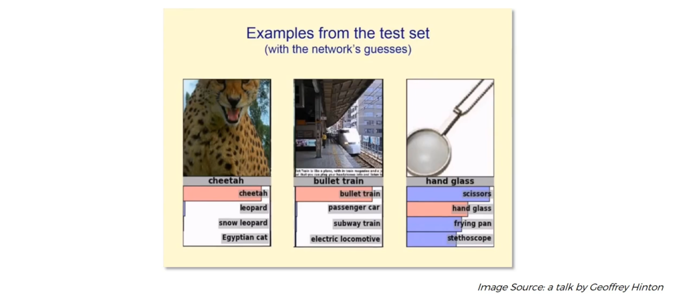
convolutional neural network

Slide 9
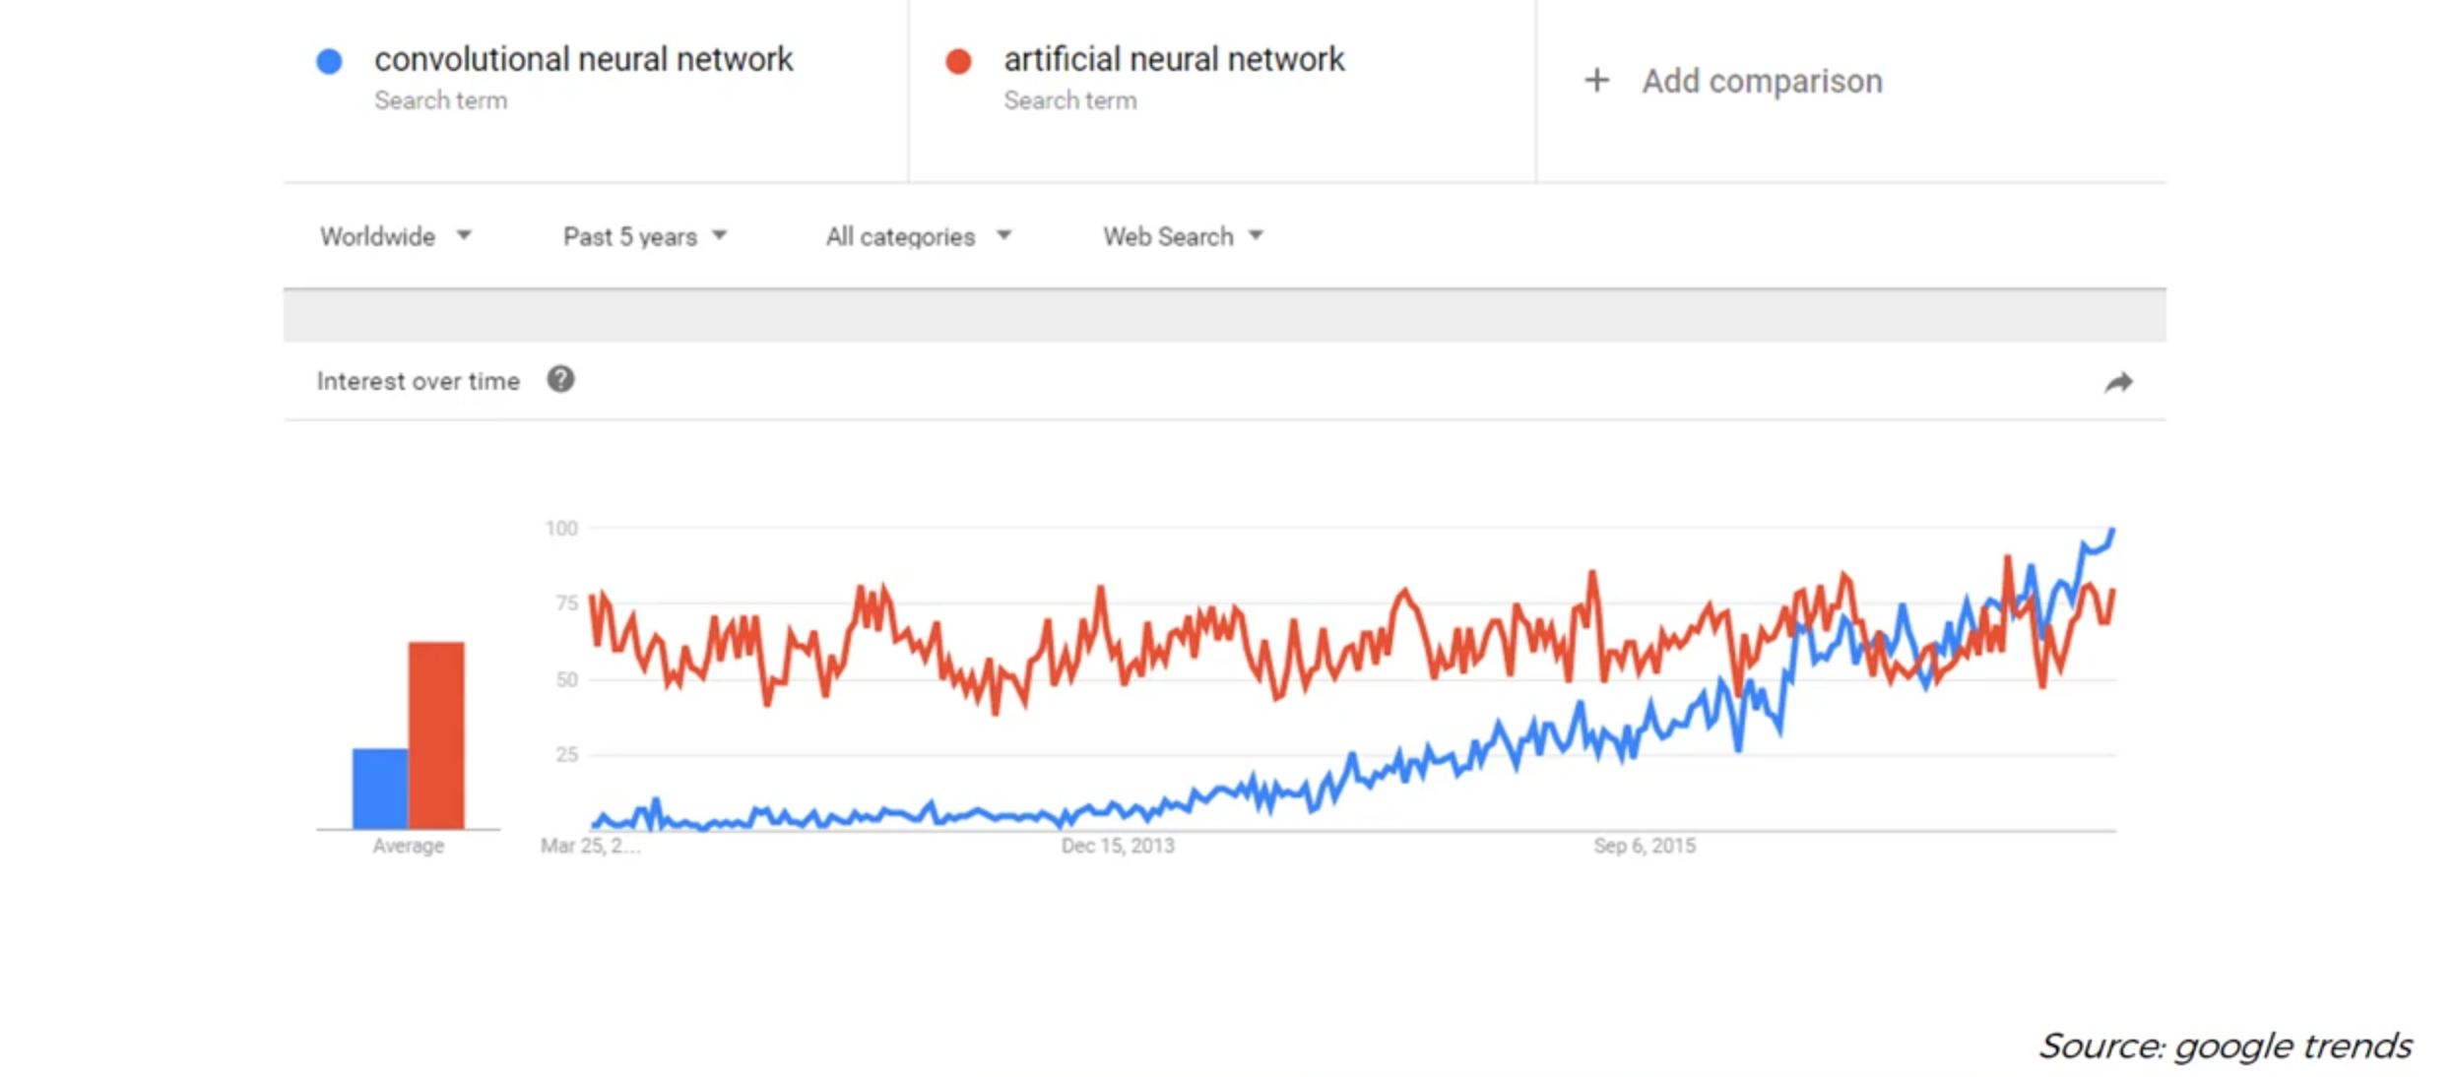
convolutional neural network

Slide 10
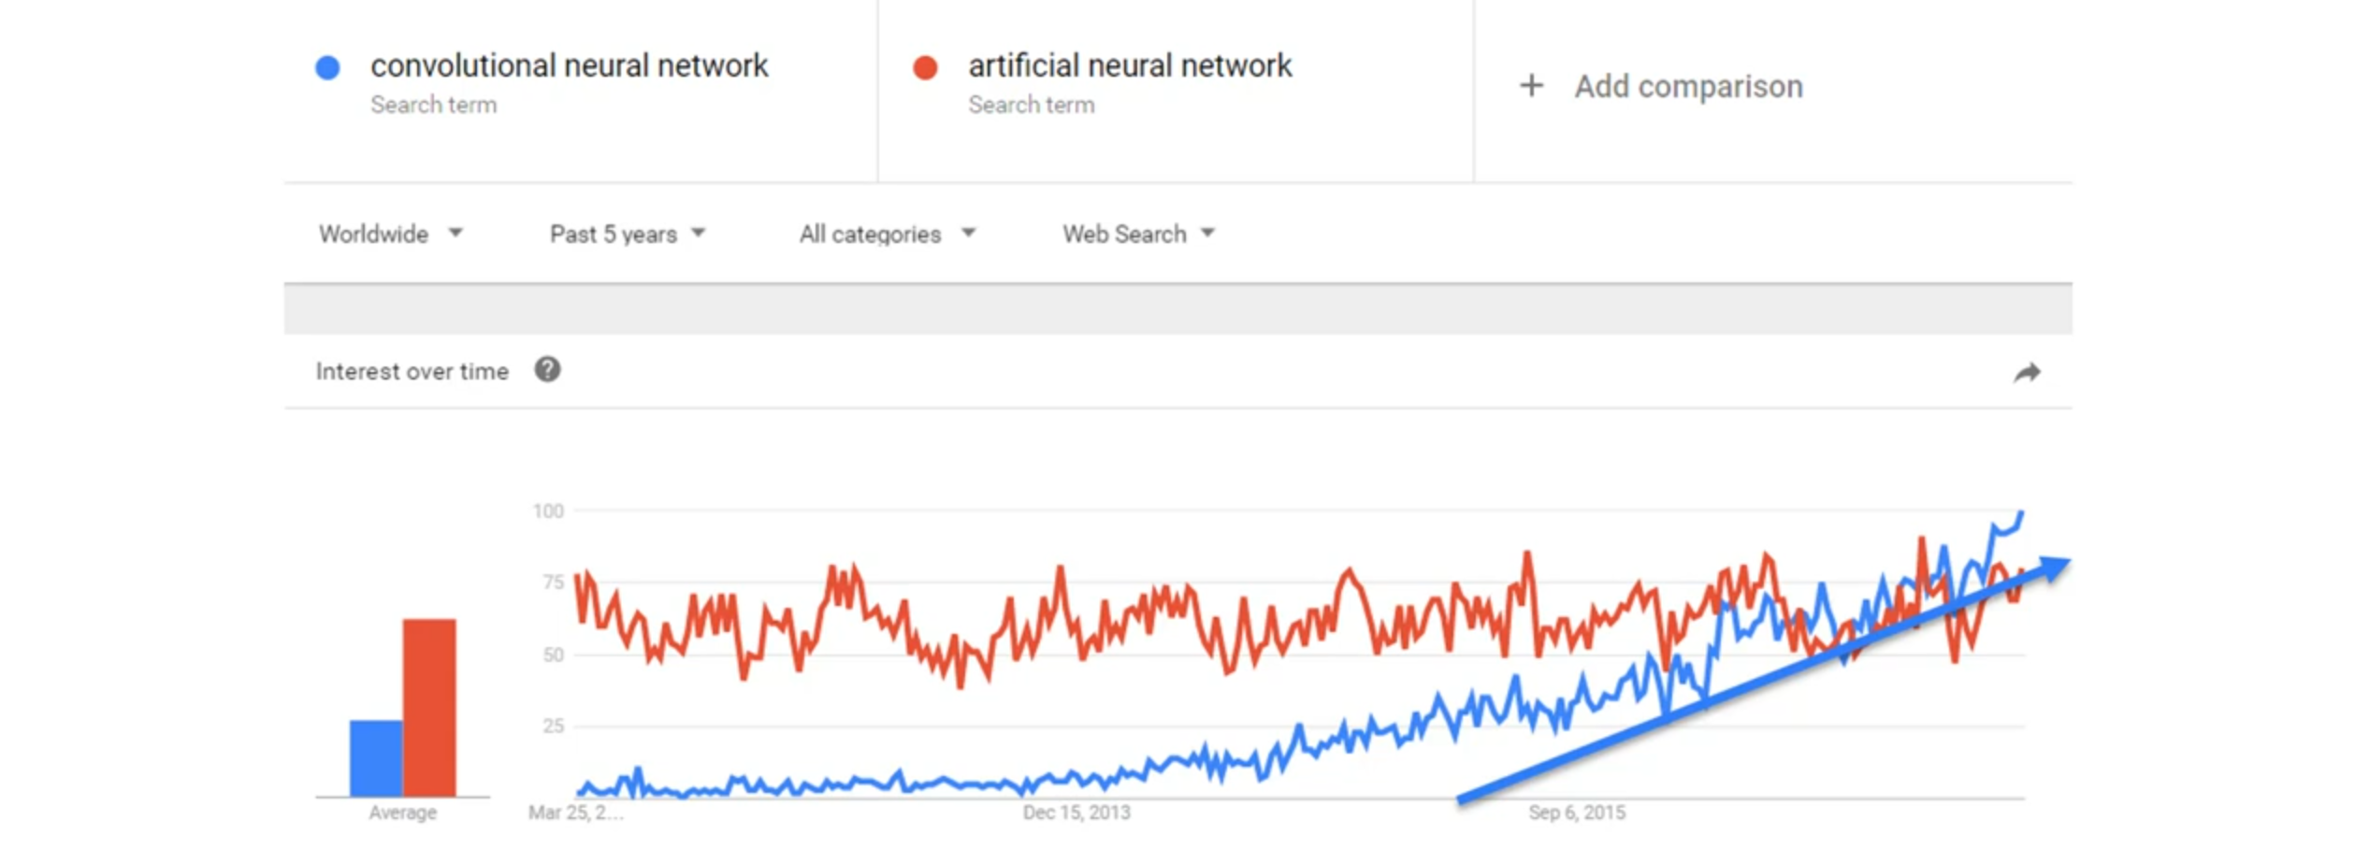
convolutional neural network

Slide 11

convolutional neural network

Slide 12
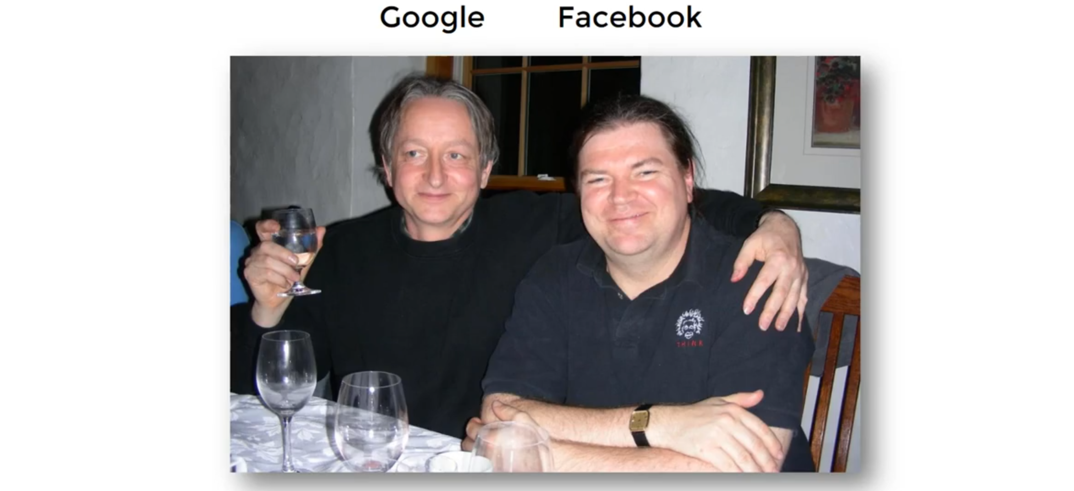
convolutional neural network

Slide 13
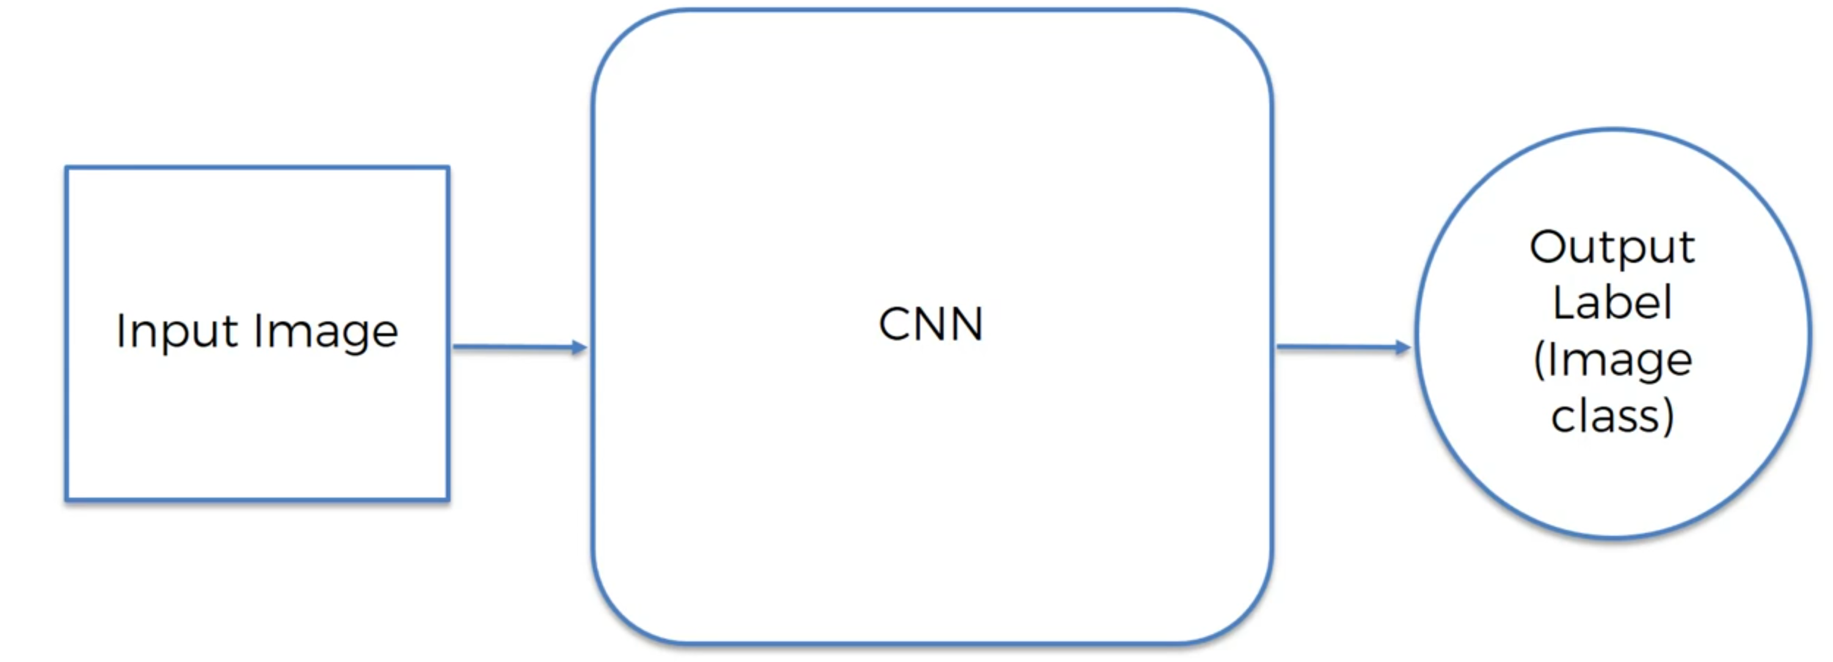
convolutional neural network

Slide 14
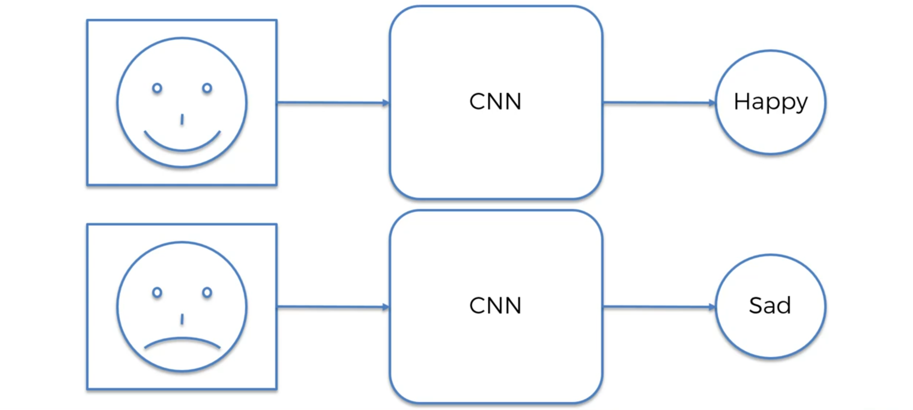
convolutional neural network

Slide 15
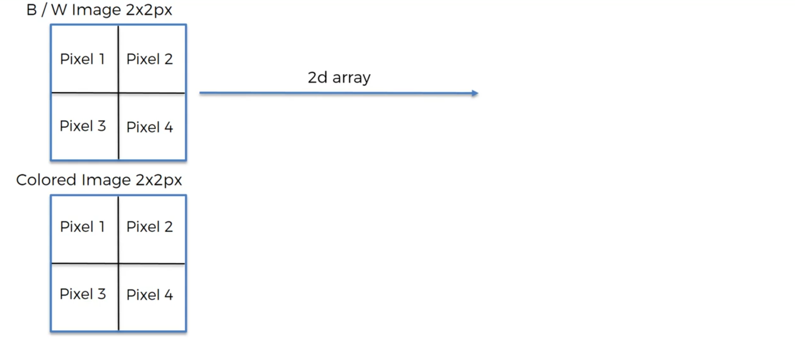
convolutional neural network

Slide 16
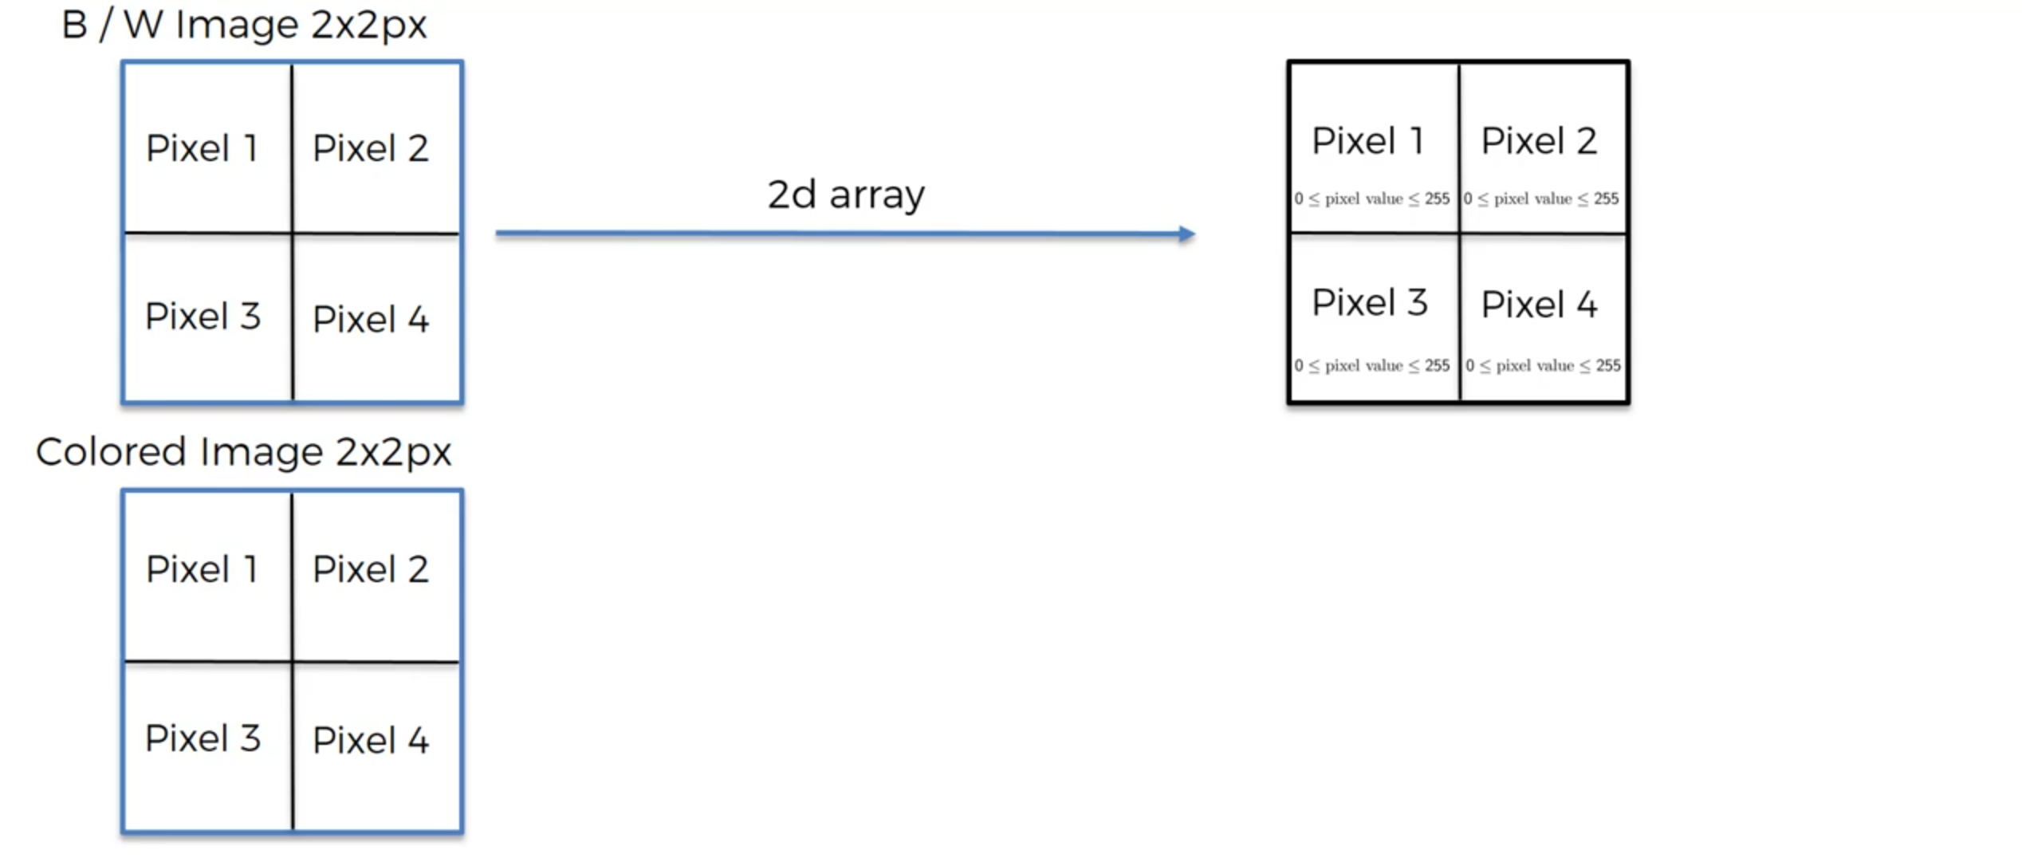
convolutional neural network

Slide 17
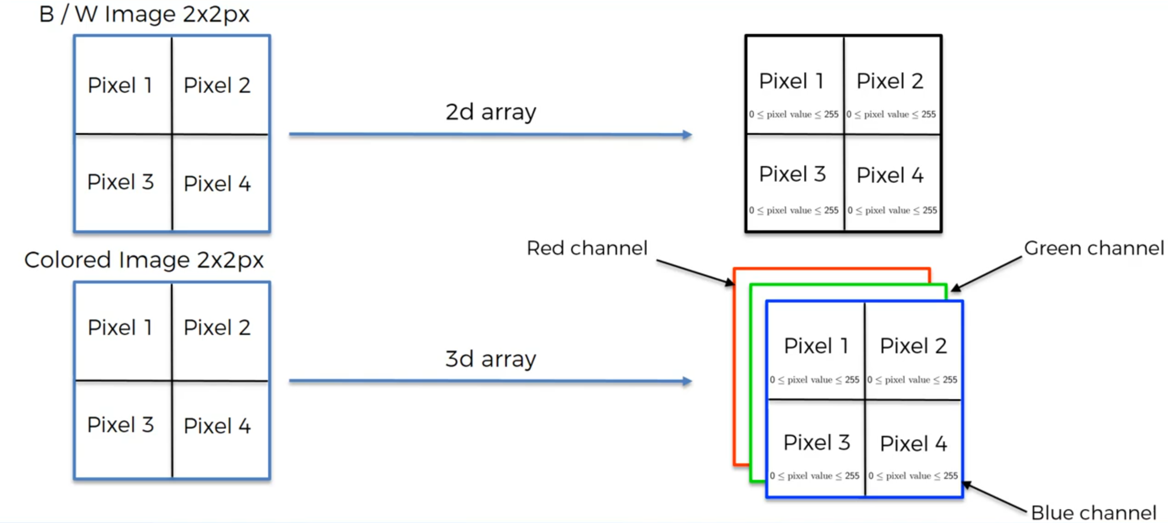
convolutional neural network

Slide 18
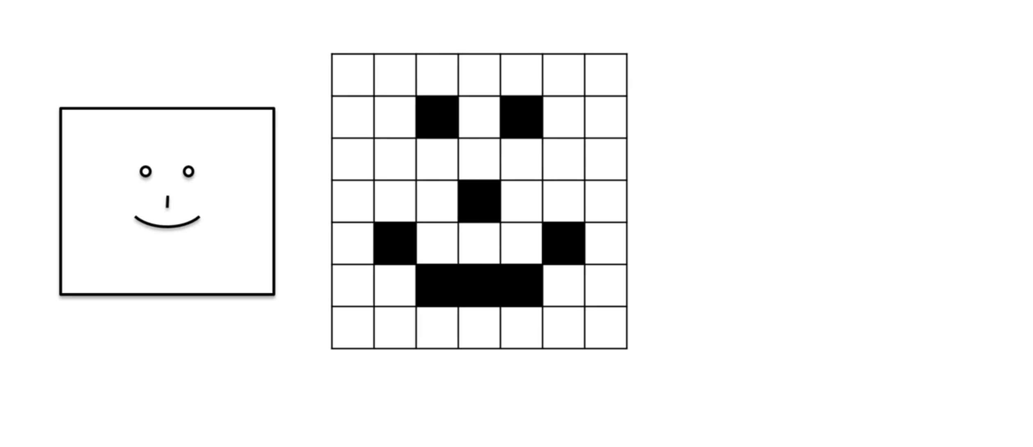
convolutional neural network

Slide 19
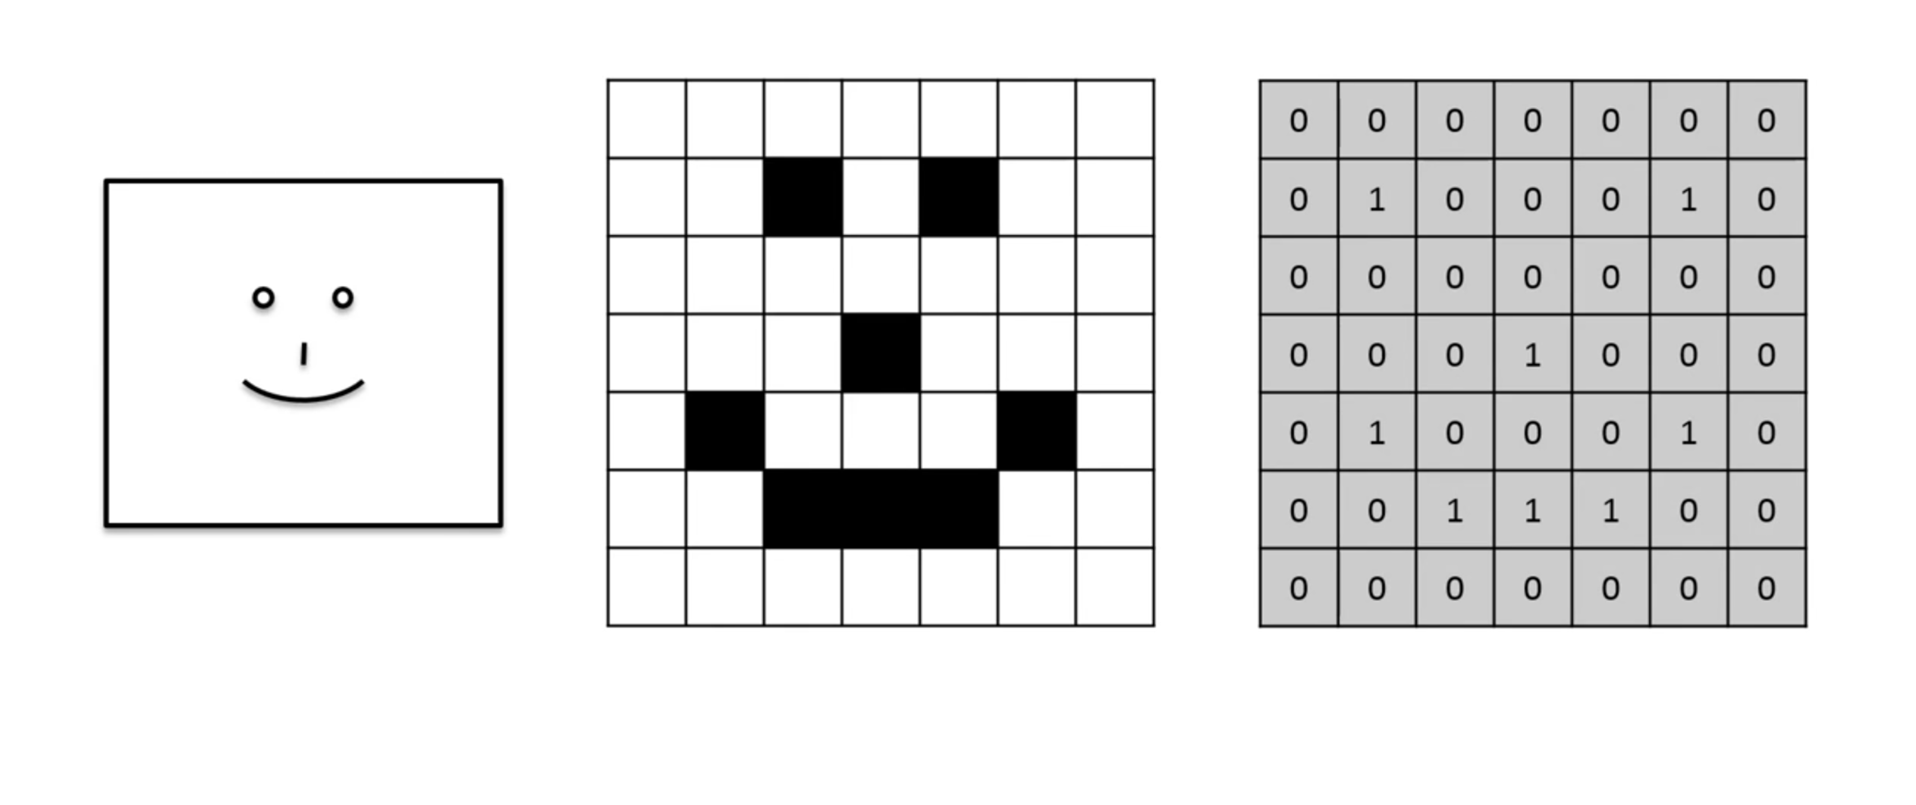
convolutional neural network

Slide 20
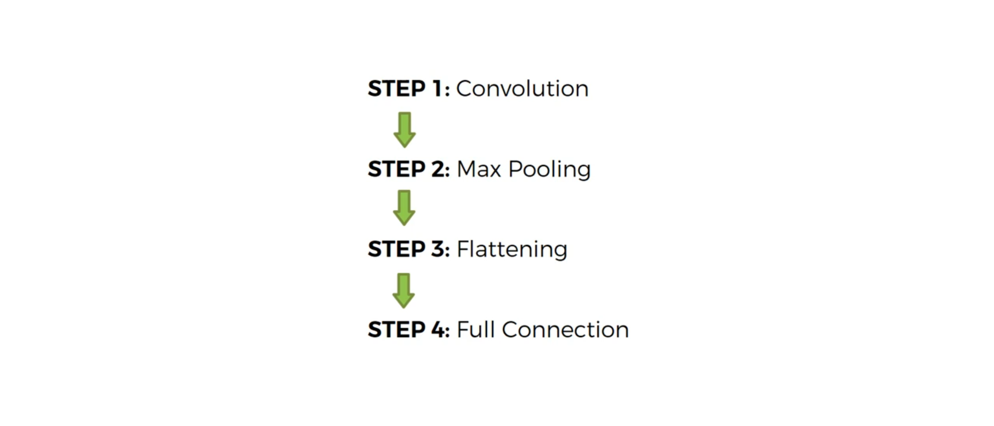
convolutional neural network

Slide 21
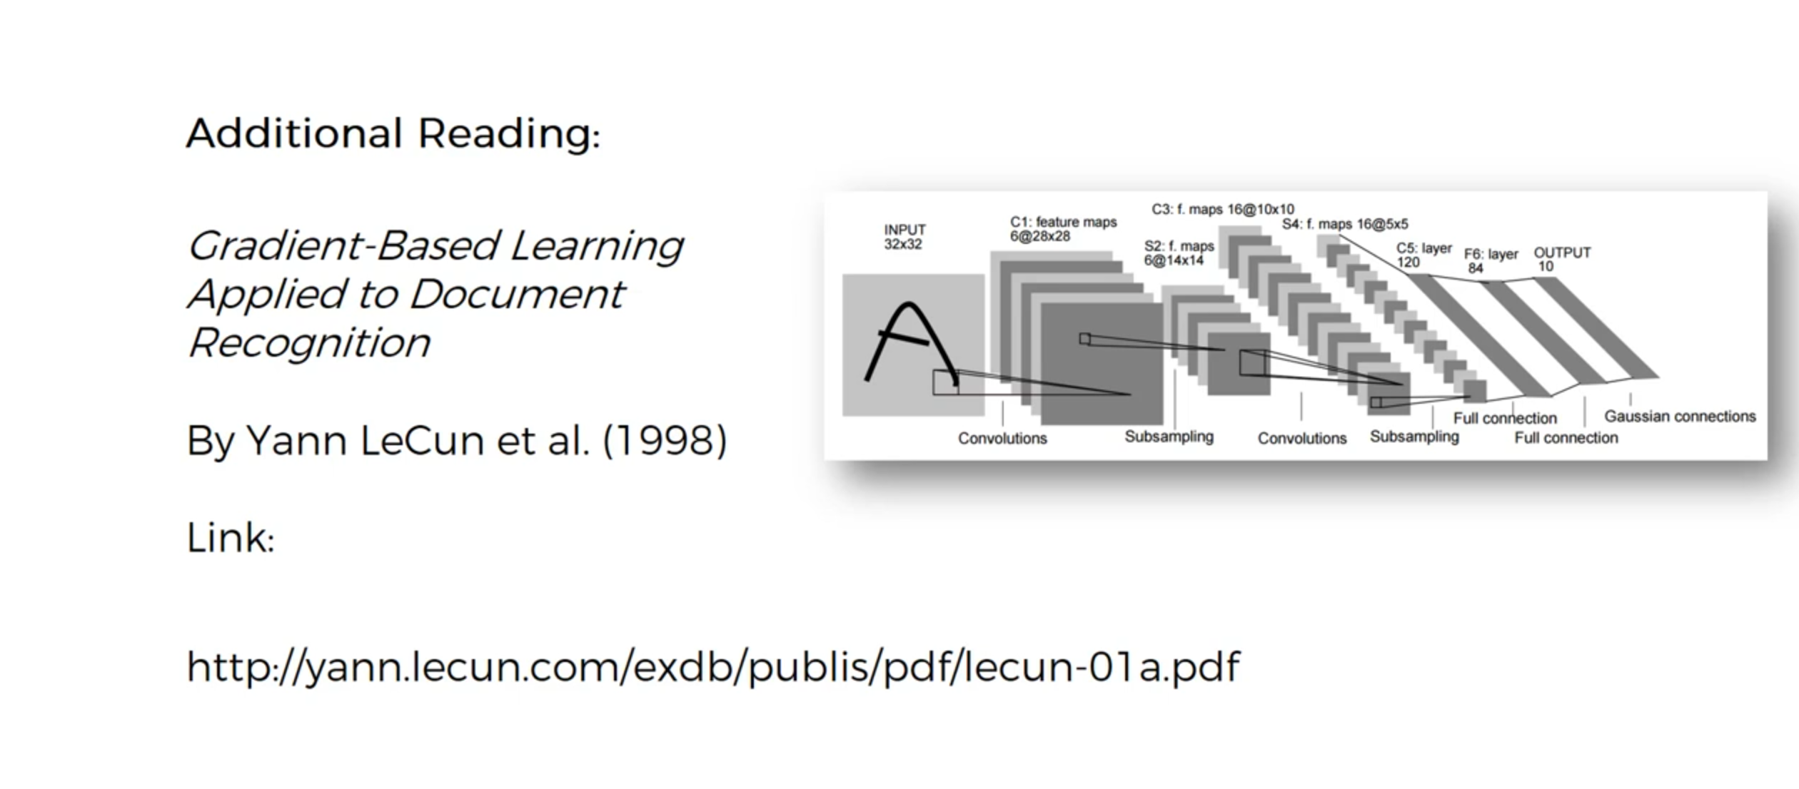
convolutional neural network

Slide 22
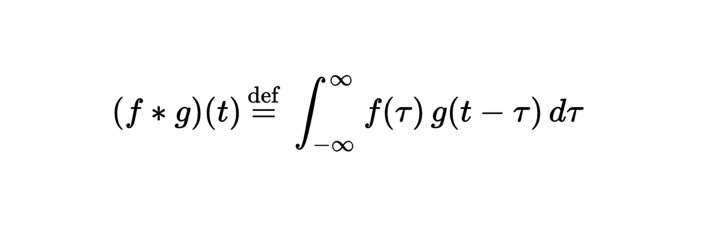
convolutional neural network

Slide 23
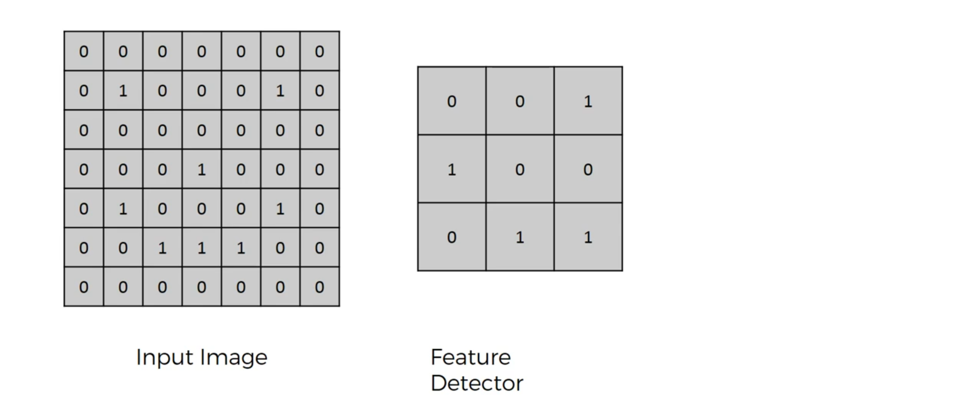
convolutional neural network

Slide 24
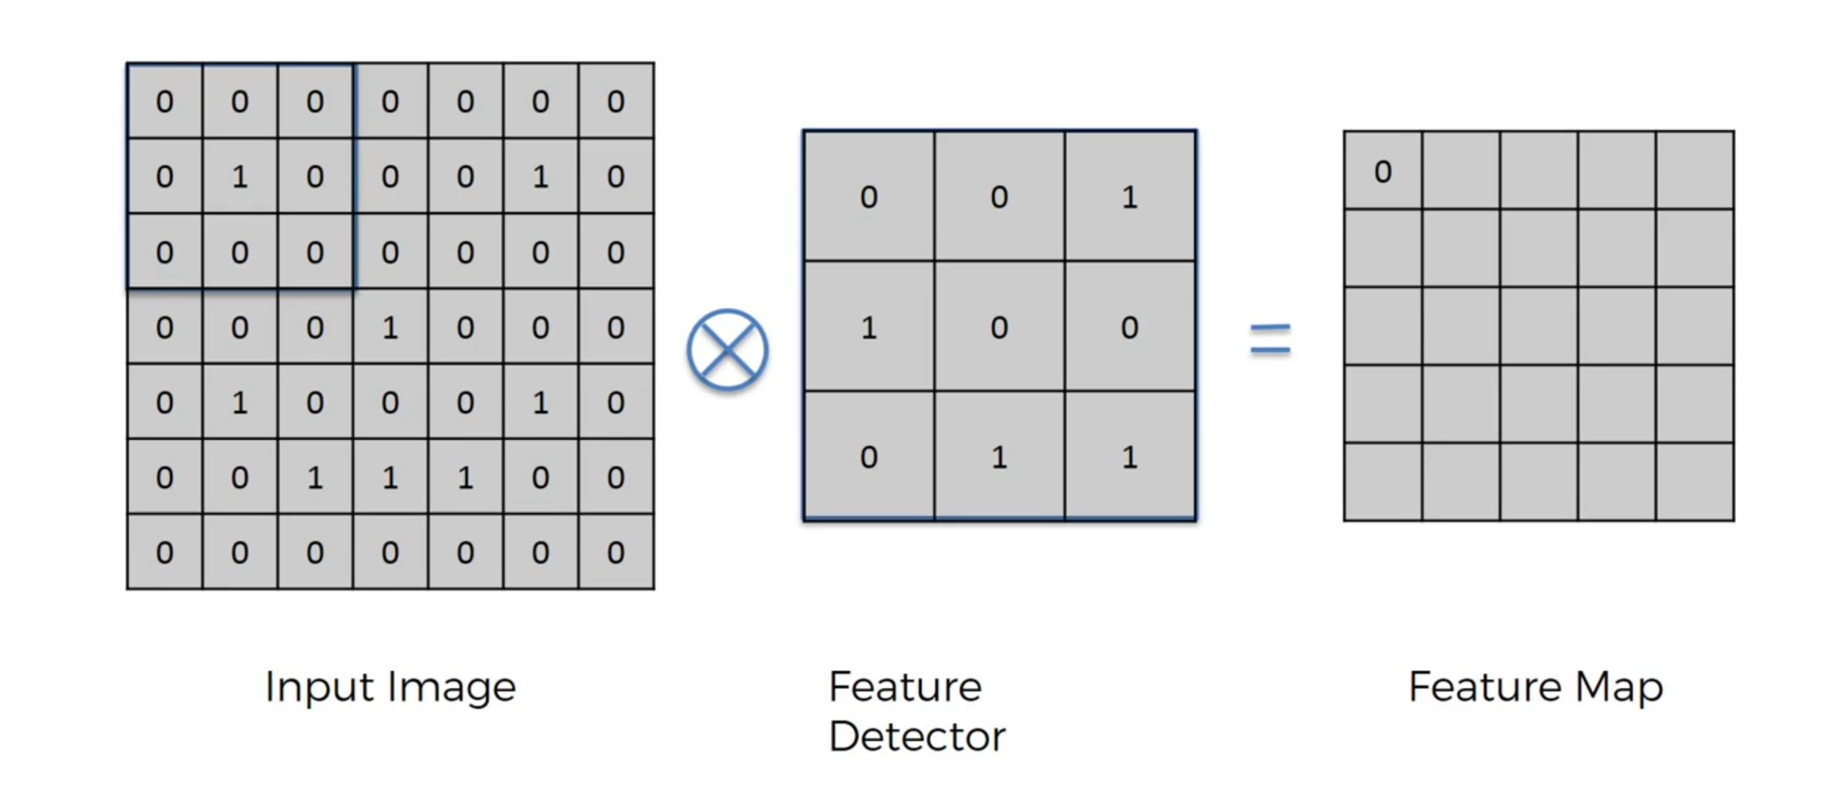
convolutional neural network

Slide 25
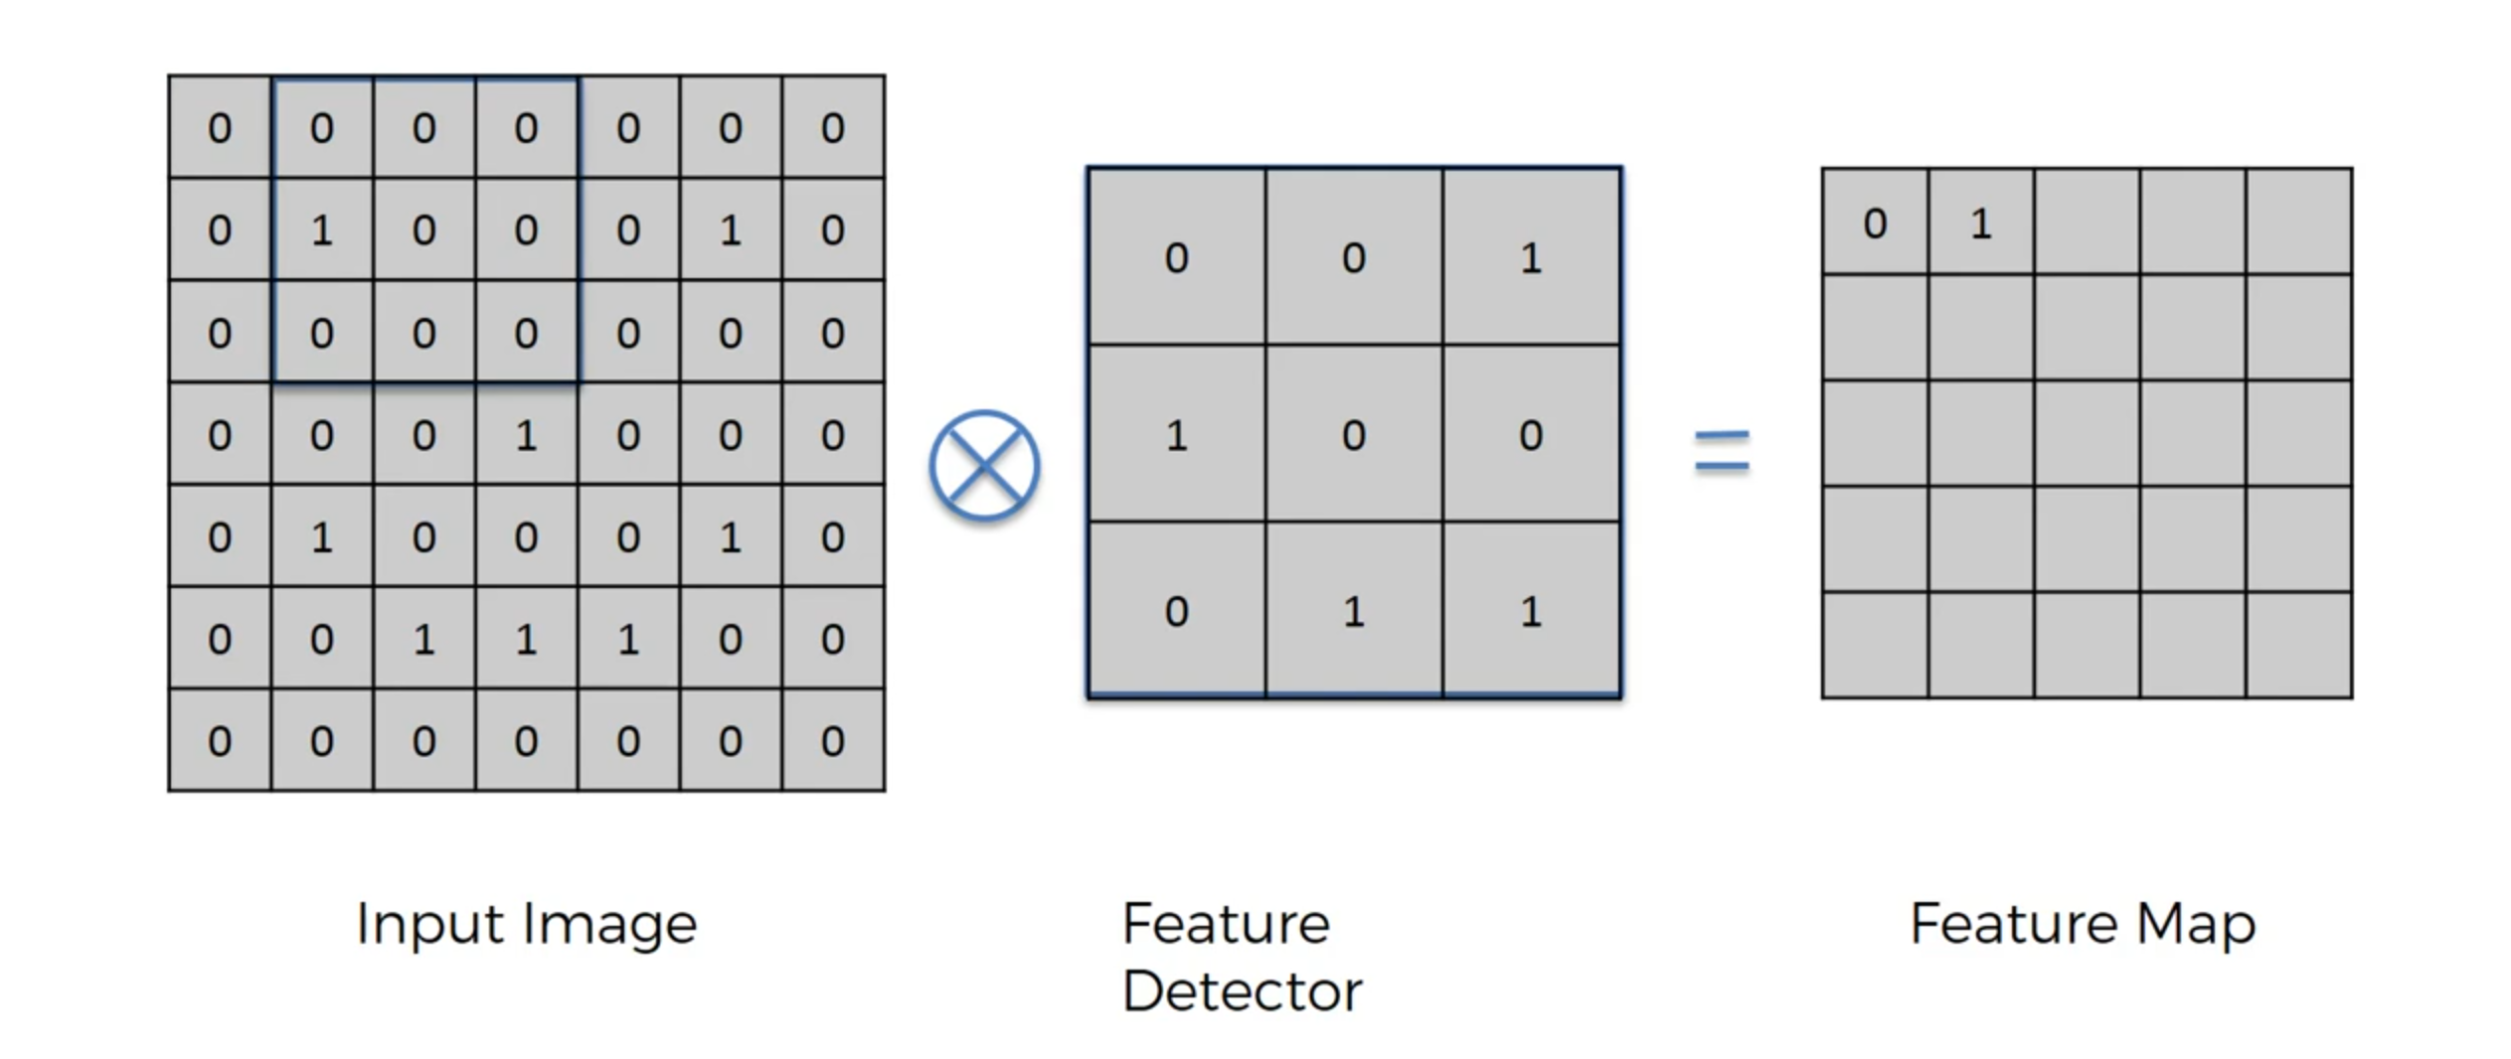
convolutional neural network

Slide 26
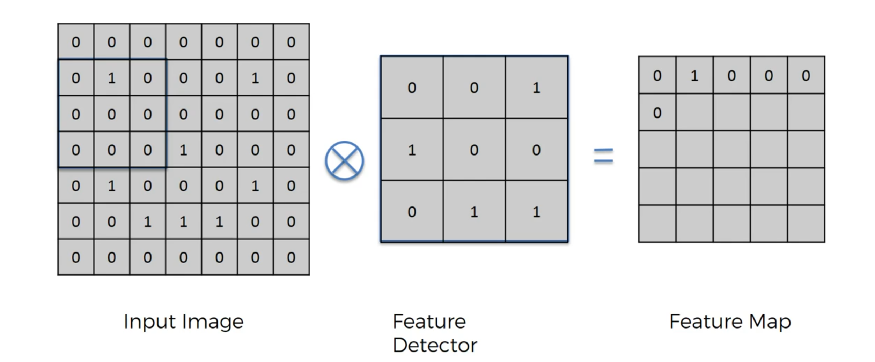
convolutional neural network

Slide 27
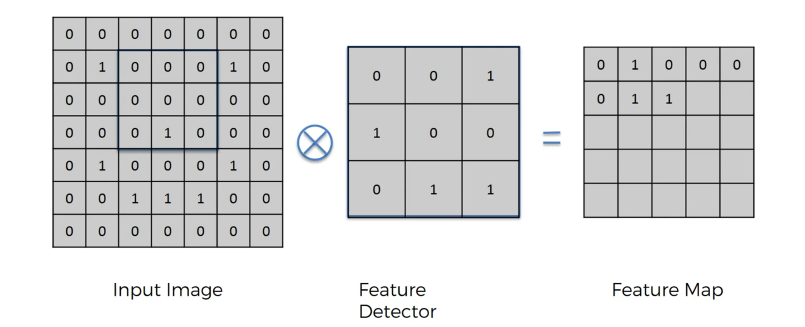
convolutional neural network

Slide 28
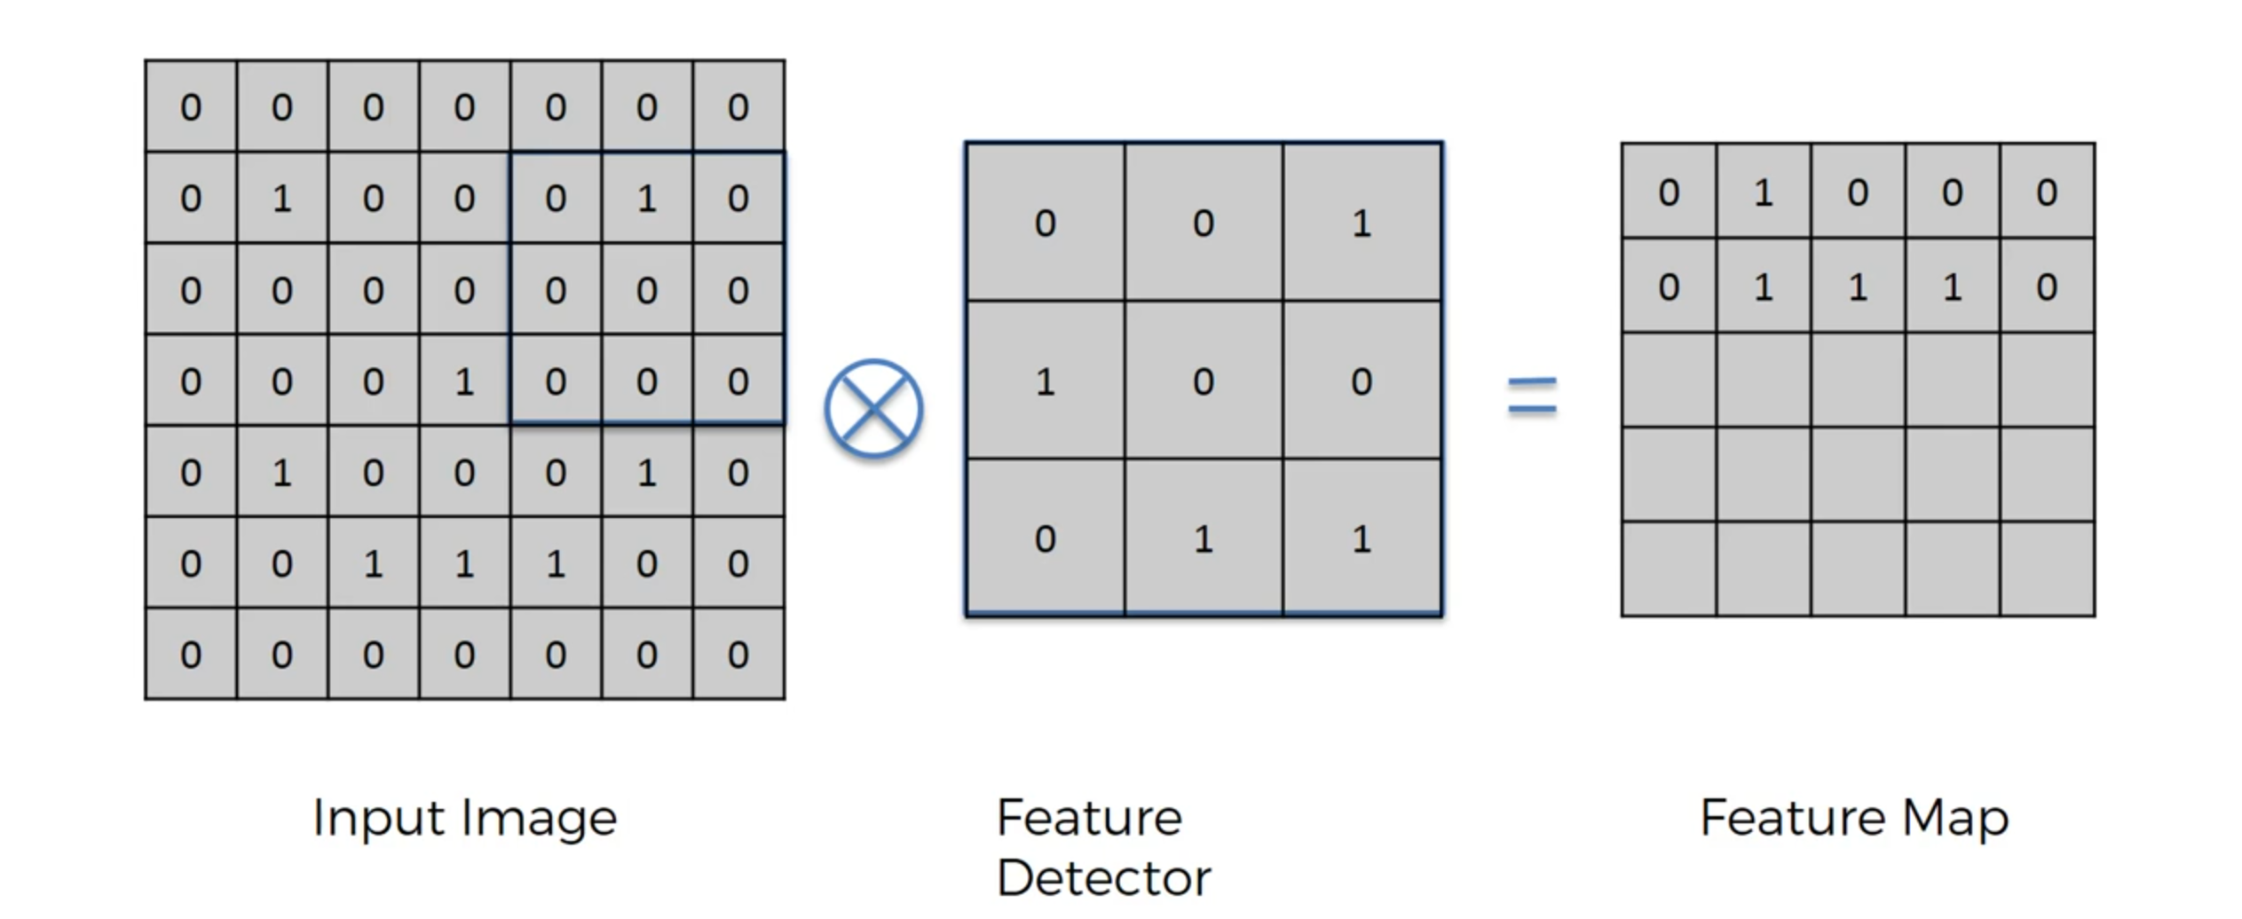
convolutional neural network

Slide 29
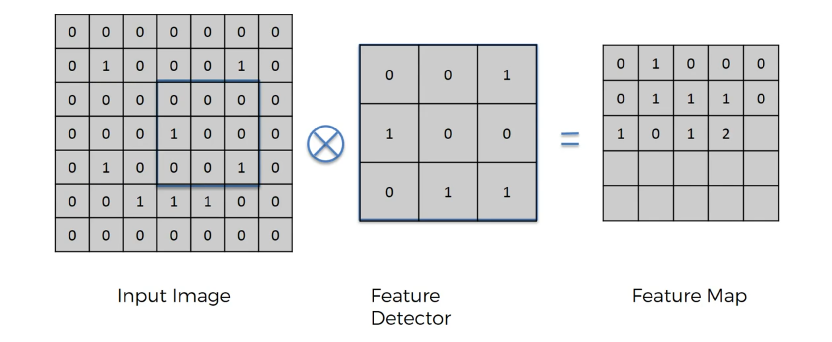
convolutional neural network

Slide 30
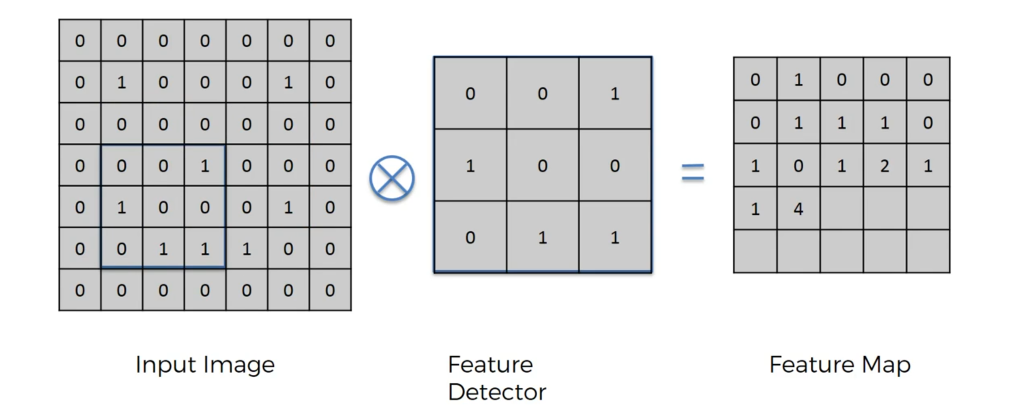
convolutional neural network

Slide 31
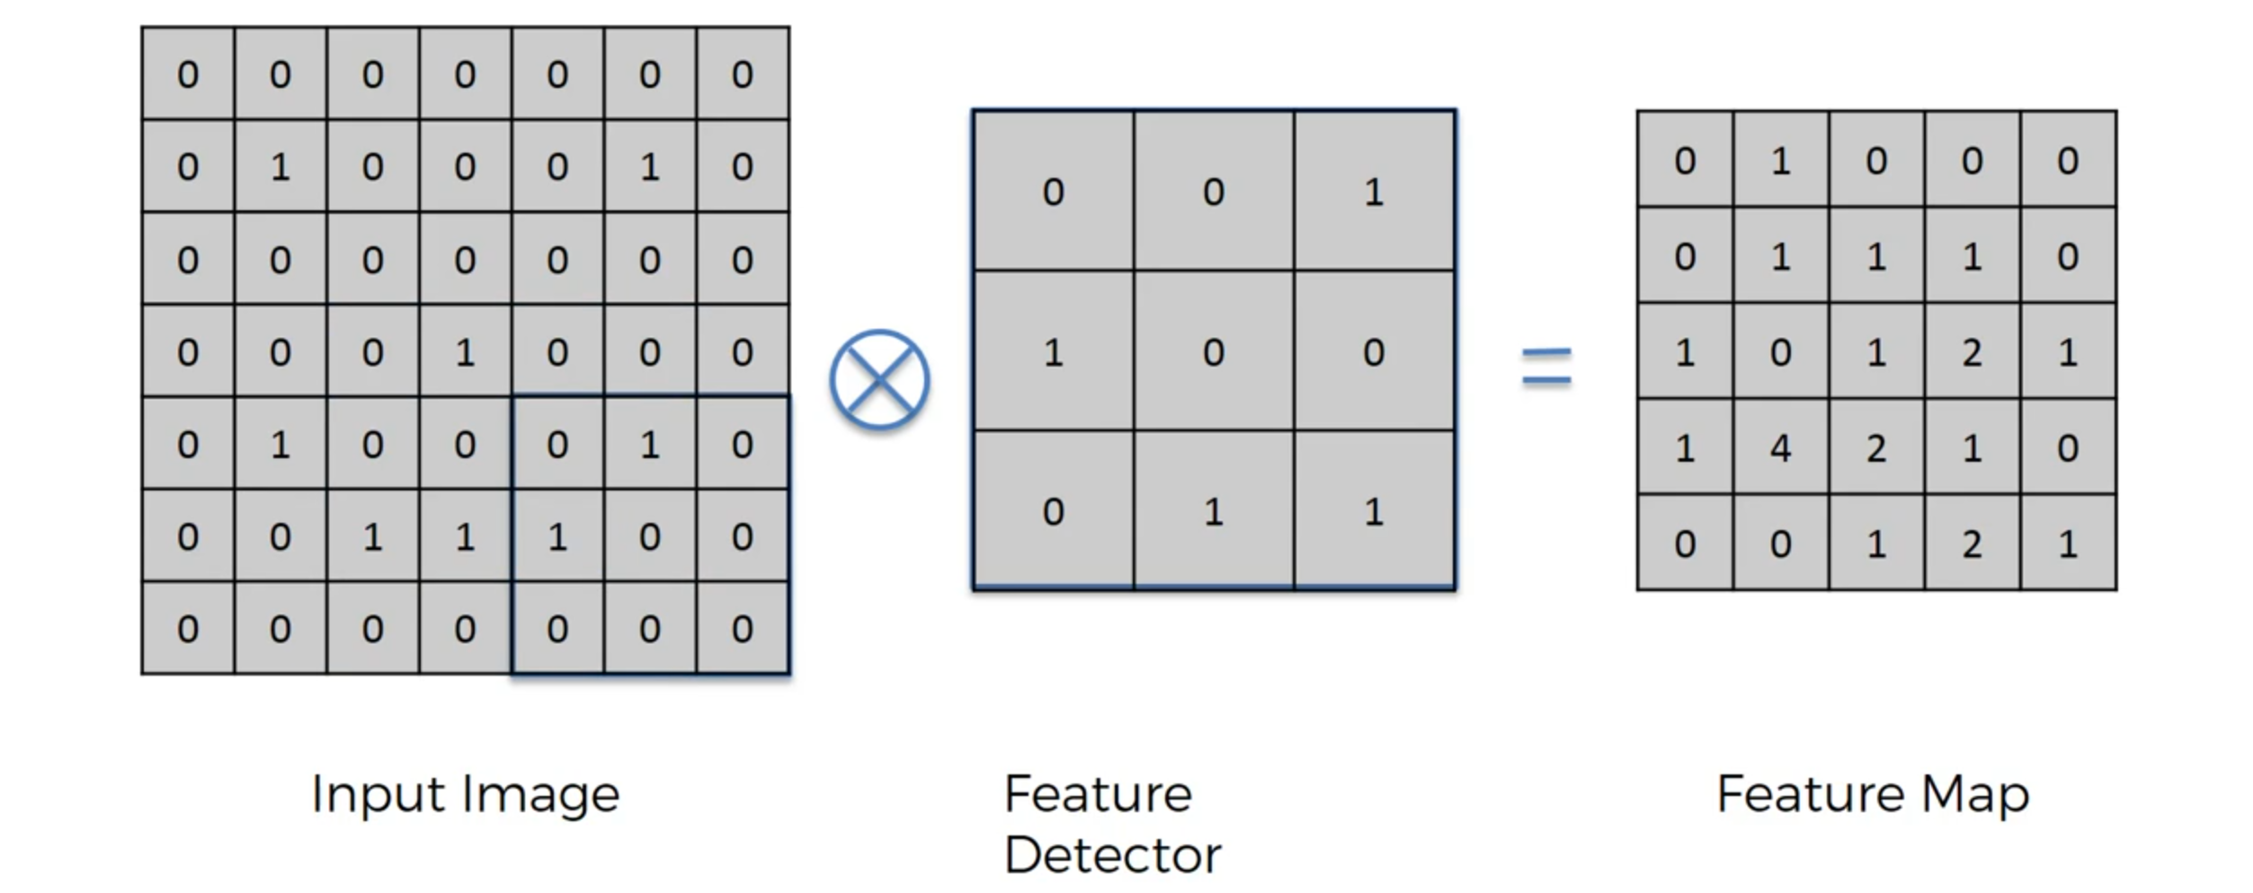
convolutional neural network

Slide 32
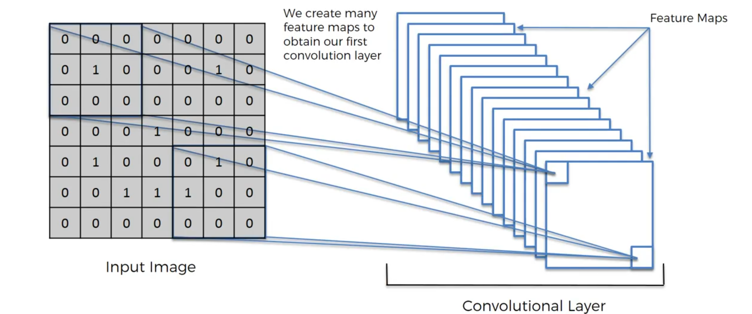
convolutional neural network
Different filters to detect different features!

Slide 33
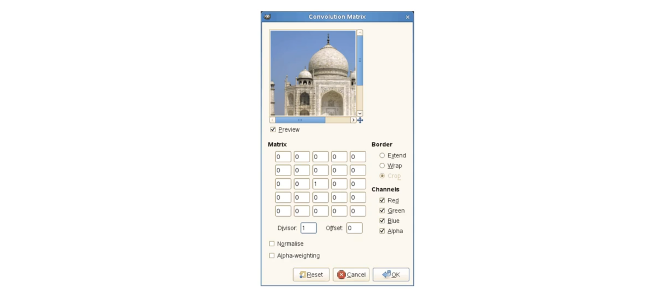
convolutional neural network
https://docs.gimp.org/2.8/en/plug-in-convmatrix.html

Slide 34
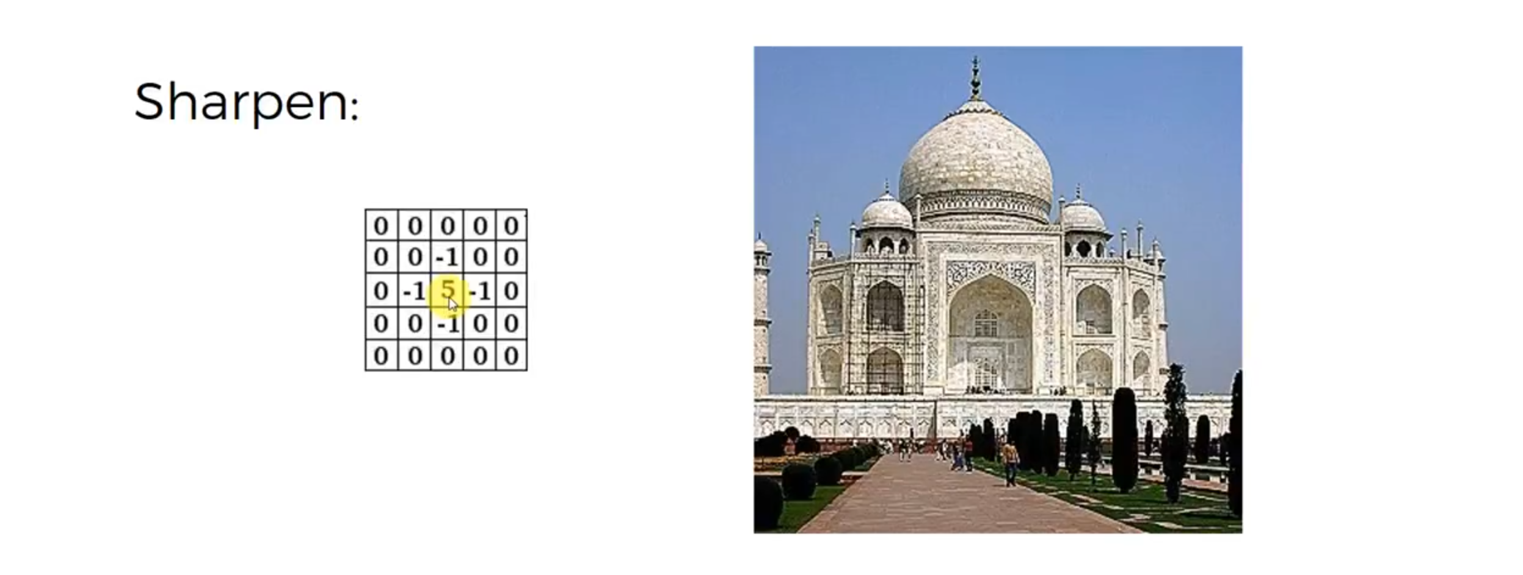
convolutional neural network

Slide 35
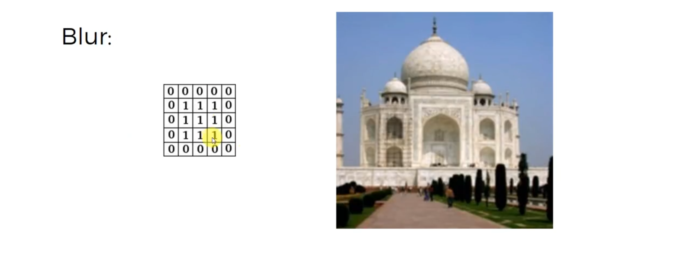
convolutional neural network

Slide 36
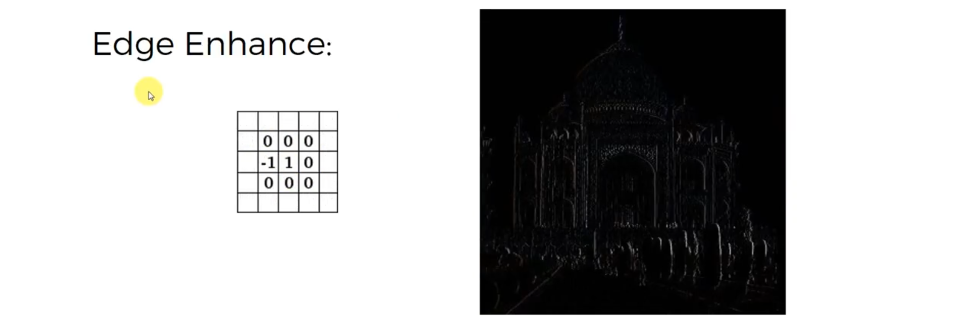
convolutional neural network

Slide 37
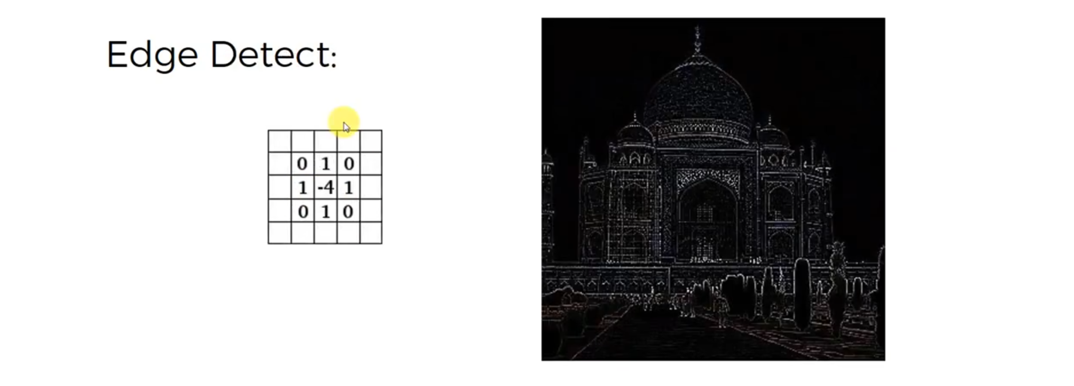
convolutional neural network

Slide 38
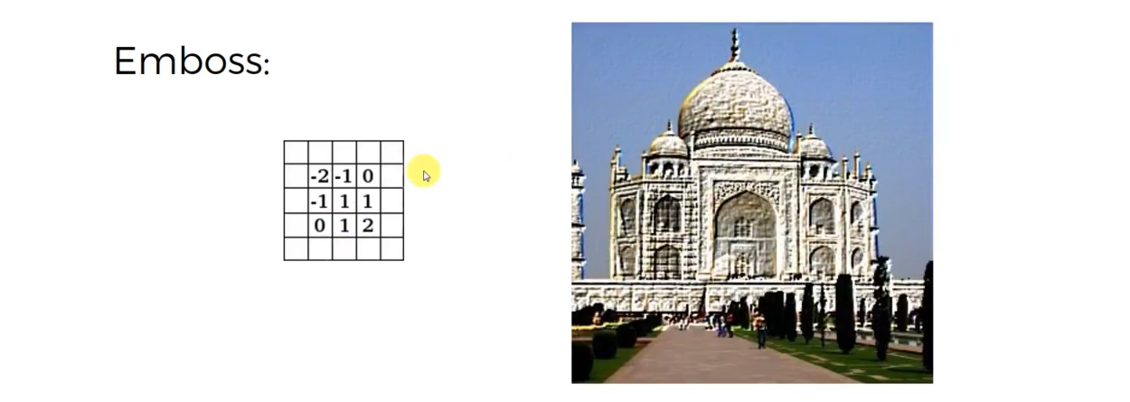
convolutional neural network

Slide 39
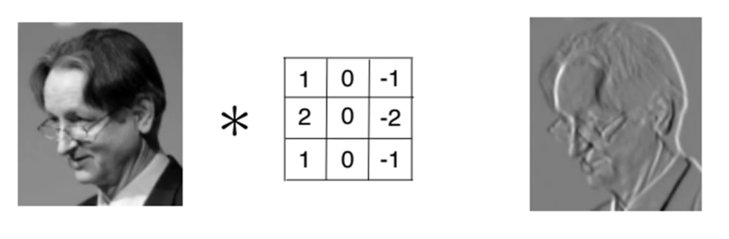
convolutional neural network

Slide 40

Rectifier Linear Unit

Slide 41
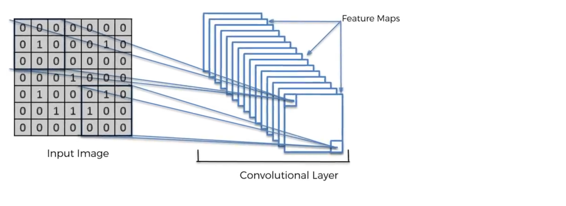
Rectifier Linear Unit

Slide 42
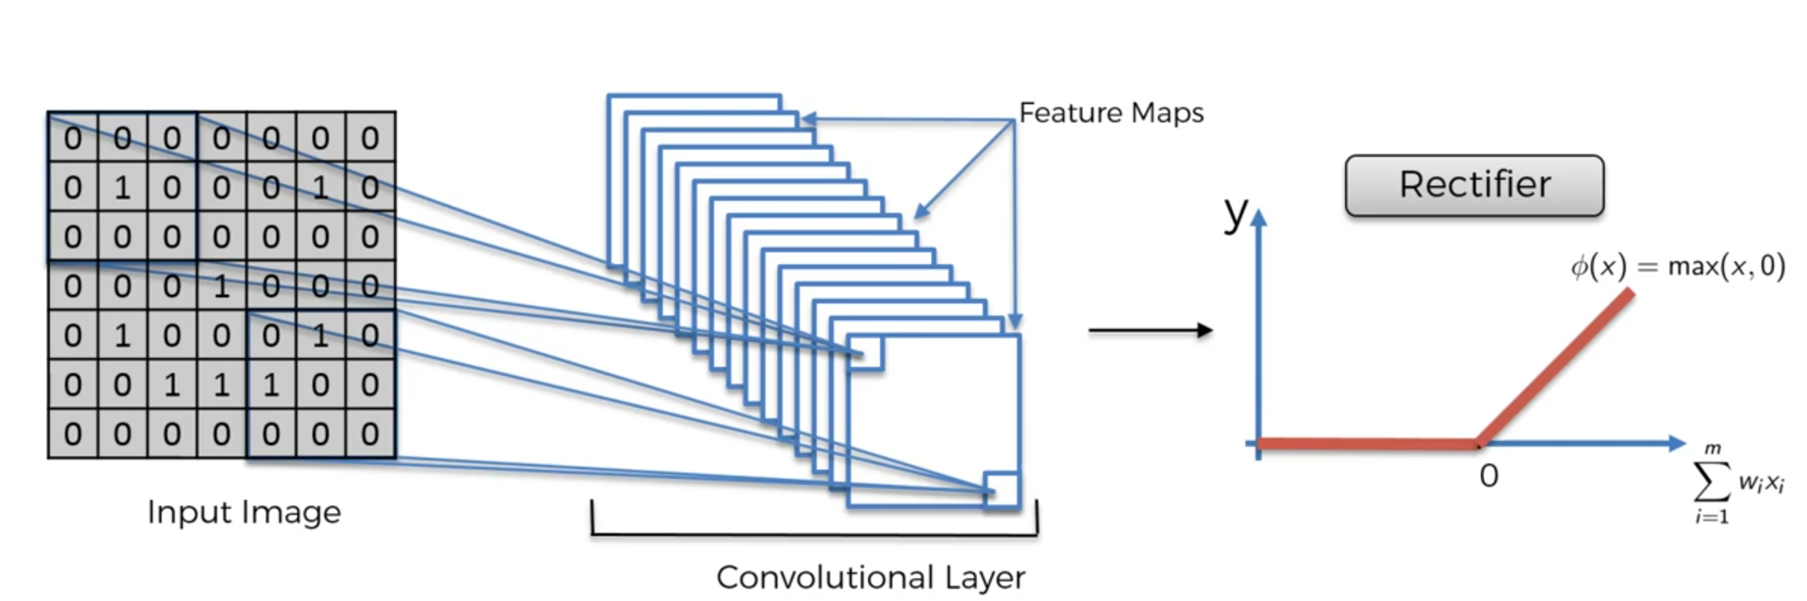
Rectifier Linear Unit
We use Rectifier to Increase non-Linearity in our CNN

Slide 43
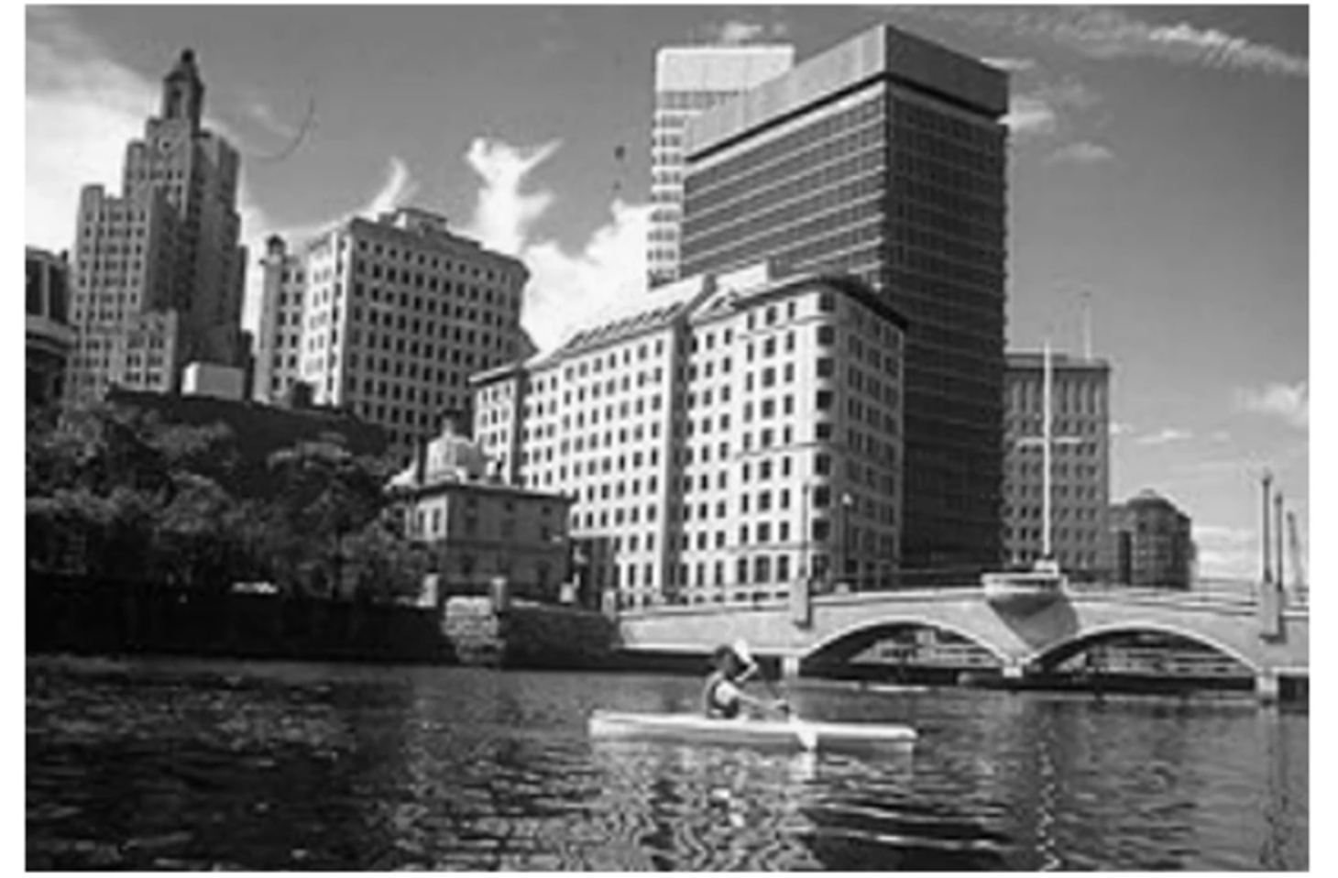
Rectifier Linear Unit

Slide 44
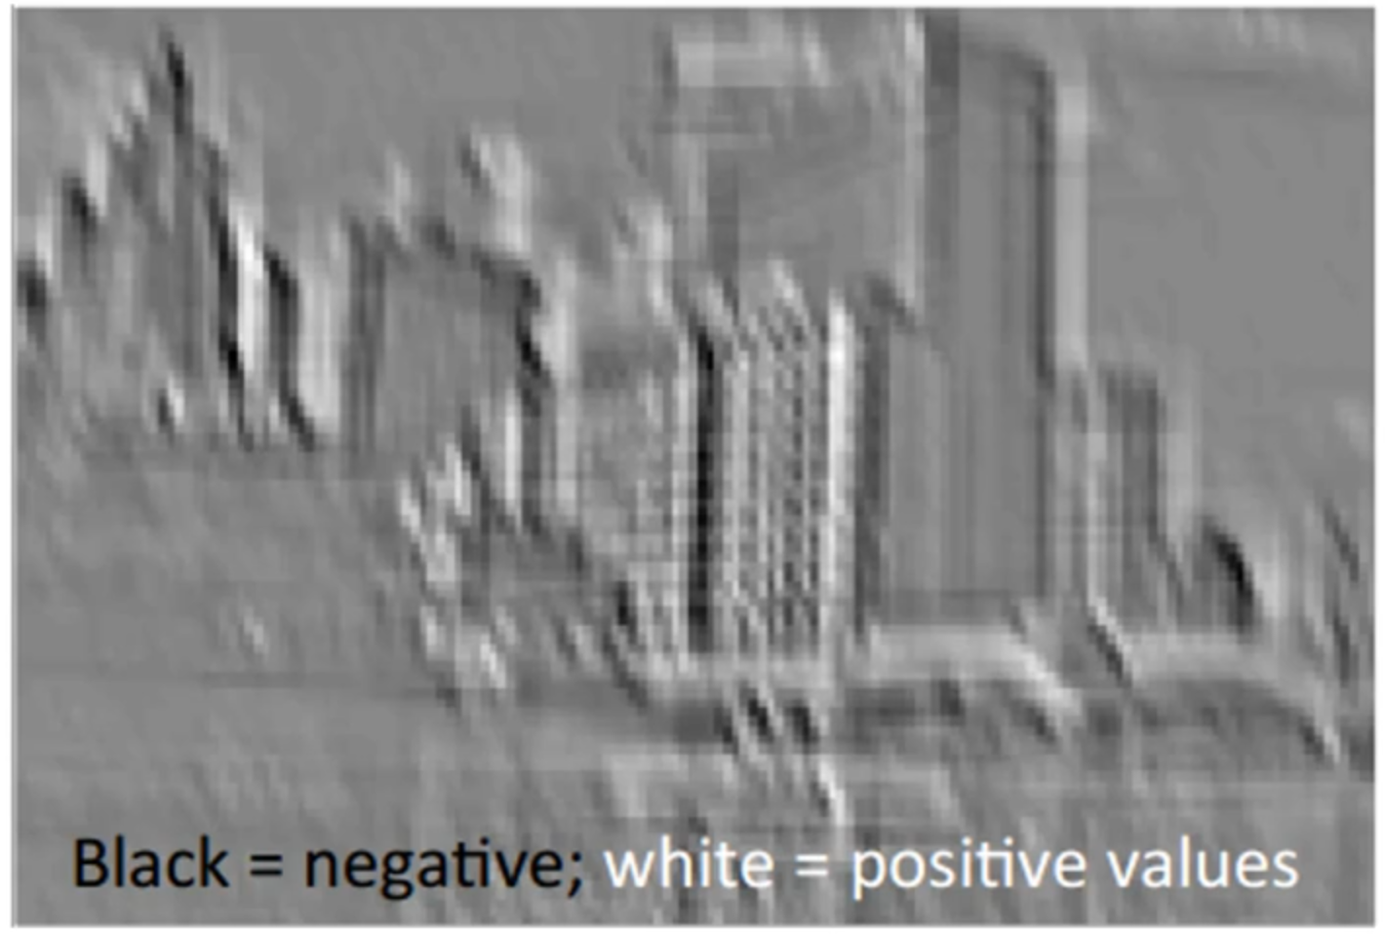
Rectifier Linear Unit

Slide 45
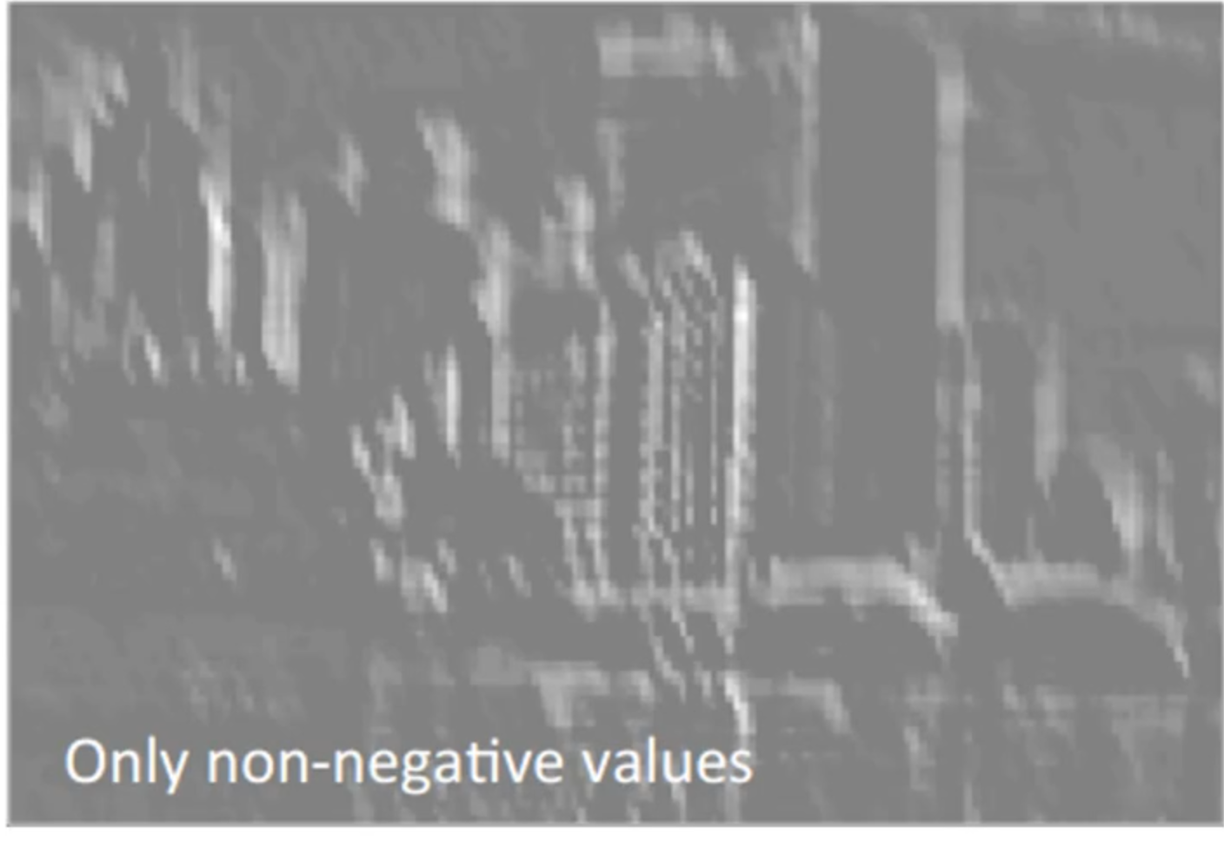
Rectifier Linear Unit

Slide 46
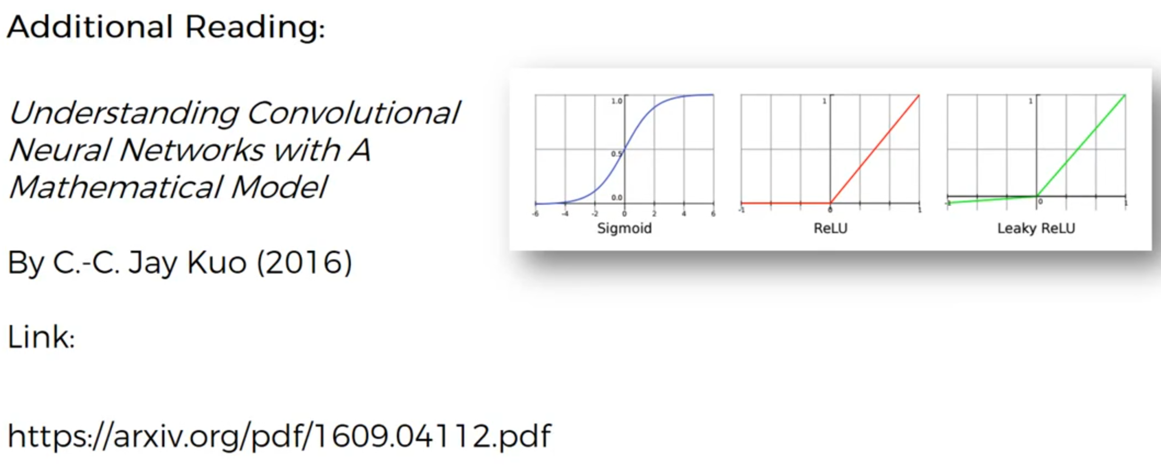
convolutional neural network

Slide 47
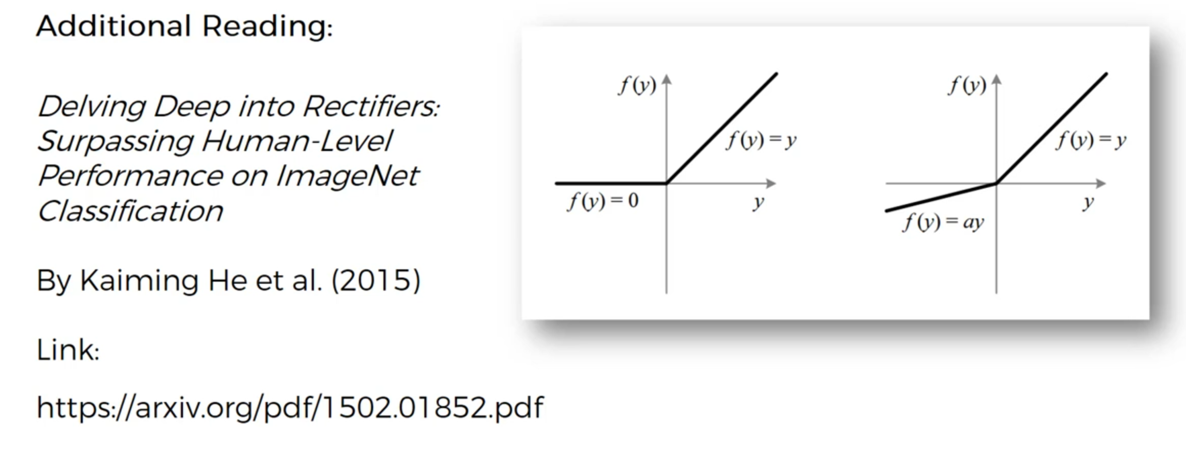
convolutional neural network

Slide 48
Pooling
Max - pooling
Min - pooling
Average - pooling

Slide 49
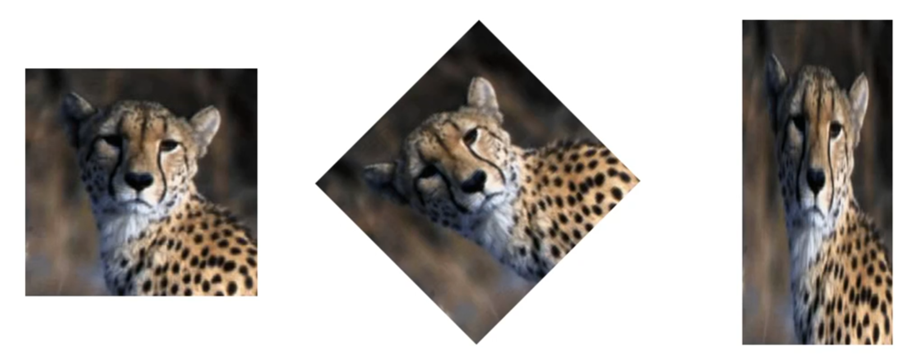
Max-Pooling

Slide 50
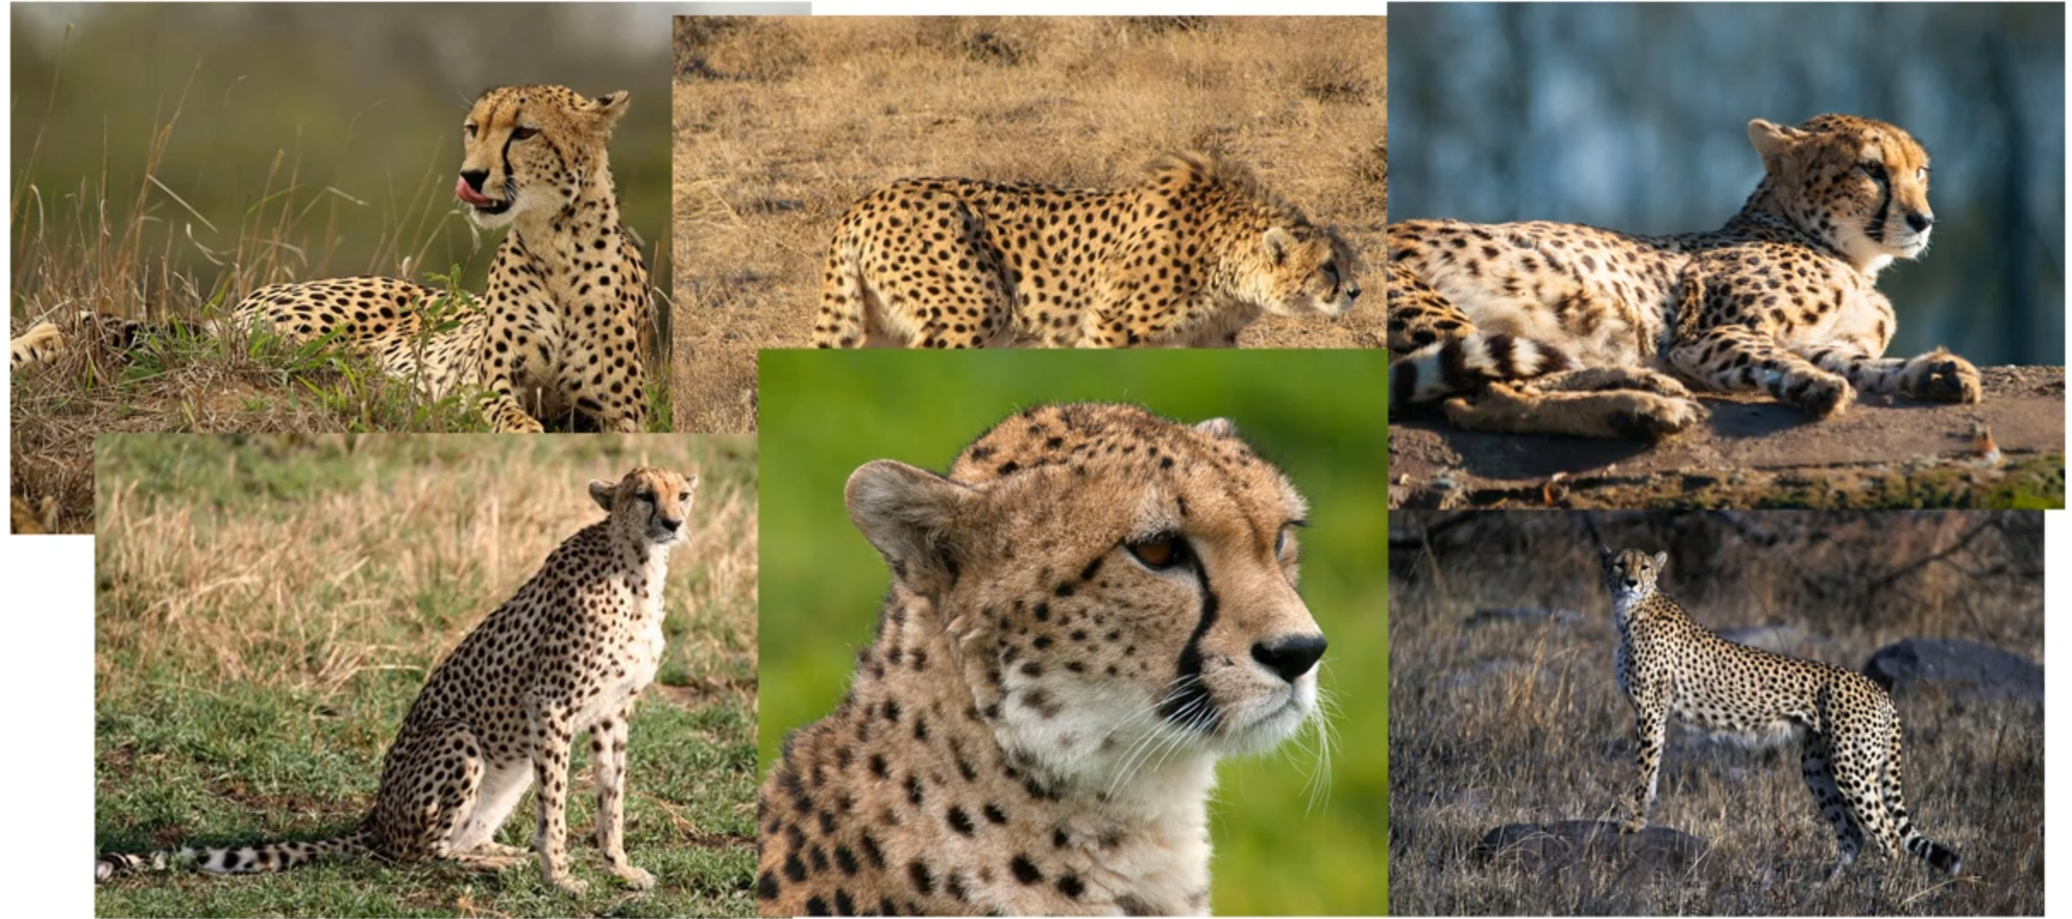
convolutional neural network

Slide 51
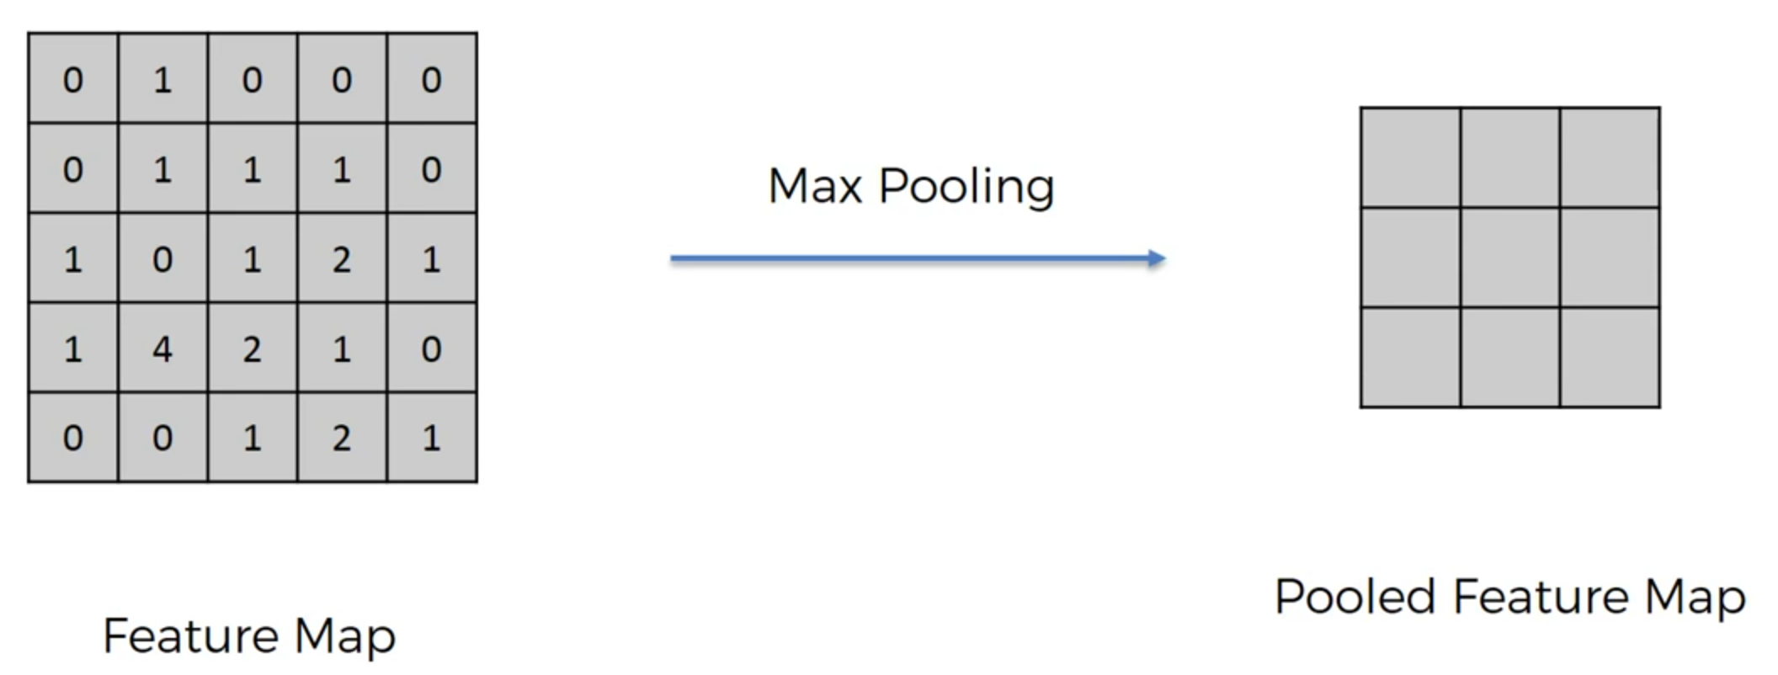
Max-Pooling

Slide 52
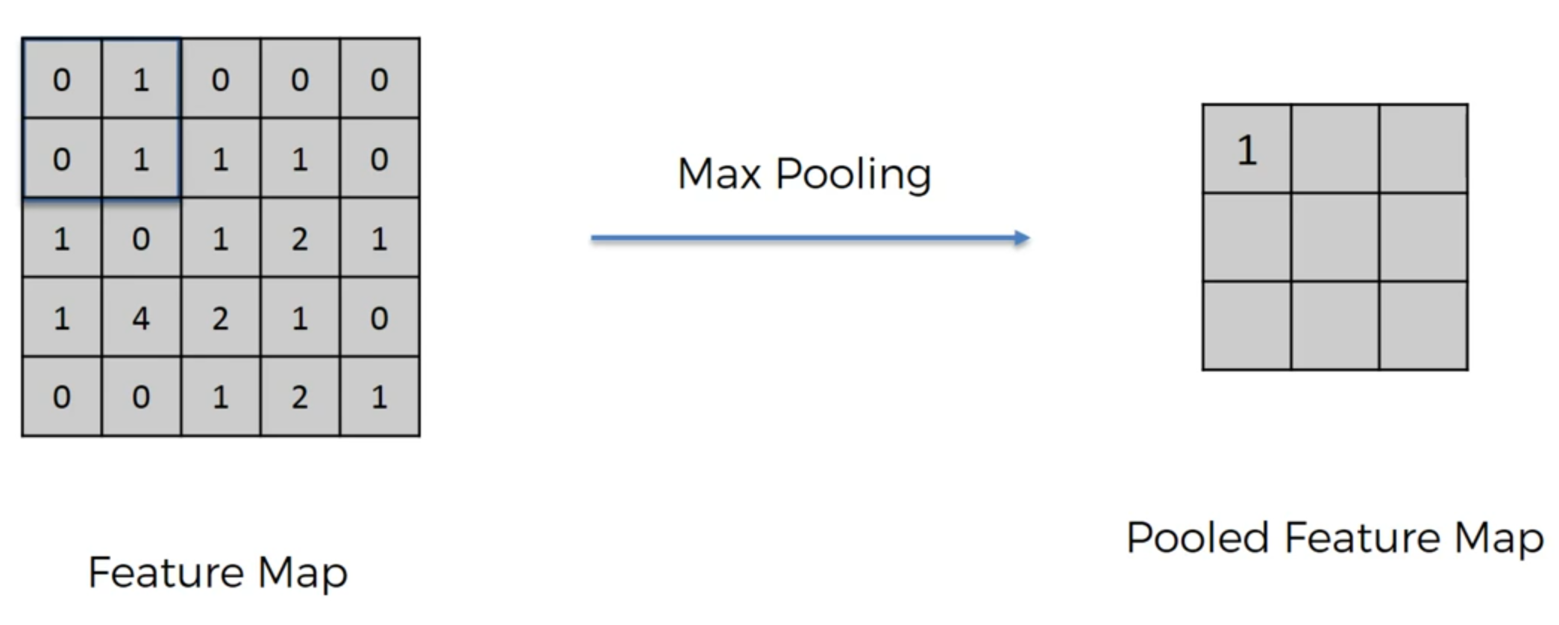

Slide 53
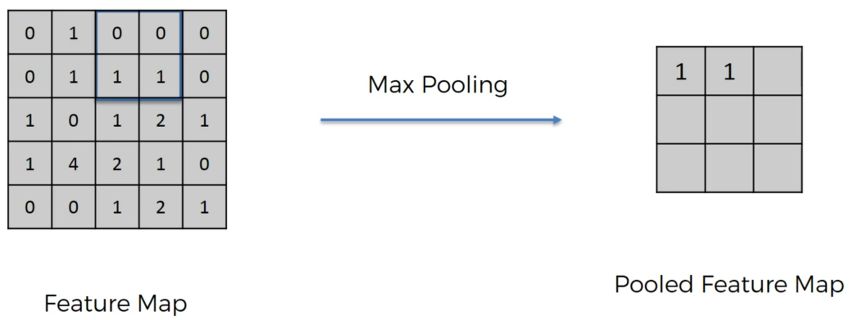

Slide 54
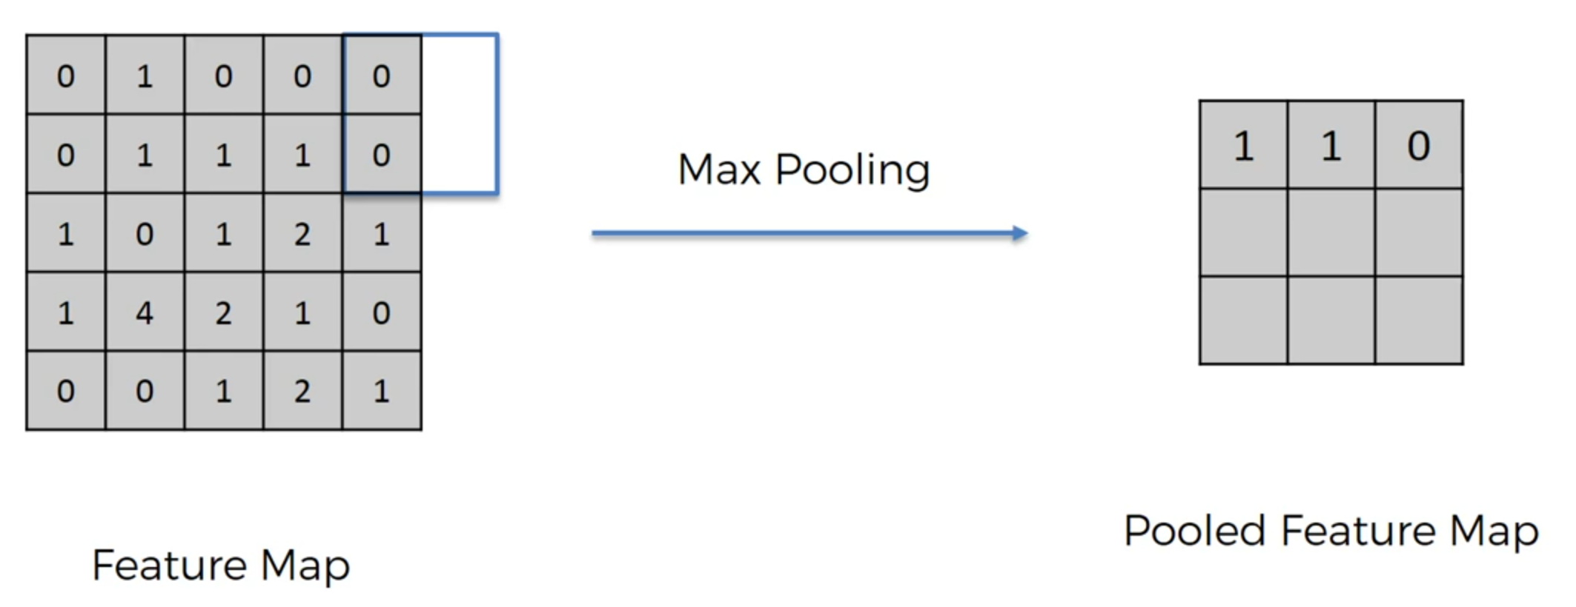

Slide 55


Slide 56

Help to detect picture rotating or …
Reducing the size…
Reducing the number of parameters…
Avoid Overfitting…

Slide 57


Slide 58
Flattening

Slide 59


Slide 60


Slide 61


Slide 62
Full Connection

Slide 63


Slide 64


Slide 65


Slide 66


Slide 67


Slide 68


Slide 69


Slide 70


Slide 71


Slide 72


Slide 73


Slide 74


Slide 75


Slide 76


Slide 77


